Slide 1
One idea per slide. The blue box is where to look; the black boxes say what it means.
Did the cues change how the regions talk?
Precon1 → Precon4 · 8 rats · gamma coherence
Shahriar · 22 October 2026
Notes:
From Jarvis, tabs 8 and 9 (the Monolith page). Every number on these slides is the tab's own.

Slide 2
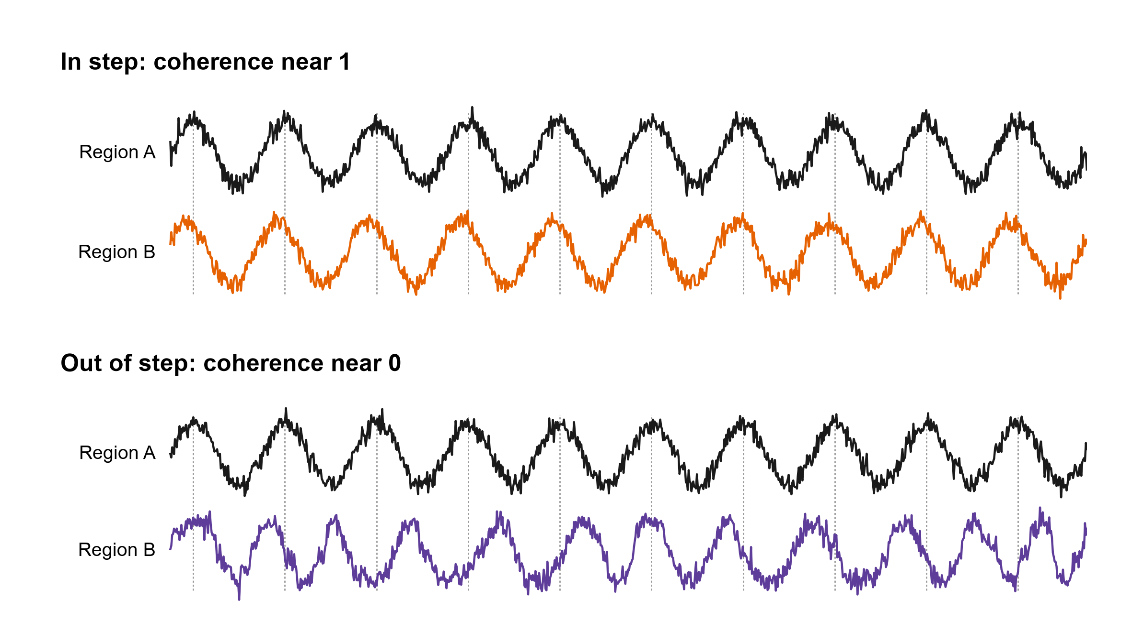
How to read this deck
One idea per slide. The blue box is where to look; the black boxes say what it means.
Coherence: how much two regions’ rhythms rise and fall together. In step, it is near 1.
Notes:
The newest note is the big red one; older ones shrink and stay on the right until the topic ends.

Slide 3
What was measured
Coherence: how much two regions’ rhythms rise and fall together. In step, it is near 1.
One idea per slide. The blue box is where to look; the black boxes say what it means.
When B’s timing drifts against A’s, it is near 0. In step, B’s peaks keep the same distance from A’s (the dotted lines).
Notes:
Coherence is computed the way Dickson et al. 2022 and Jeremy’s MATLAB do it (mscohere).

Slide 4
What was measured
Coherence: how much two regions’ rhythms rise and fall together. In step, it is near 1.
When B’s timing drifts against A’s, it is near 0. In step, B’s peaks keep the same distance from A’s (the dotted lines).
Here: gamma (30–90 Hz), between every pair of 12 regions. 44 pairs had at least 4 rats on both days.

Slide 5
What was measured
Coherence: how much two regions’ rhythms rise and fall together. In step, it is near 1.
Each trial: a baseline before cue 1, then cue 1 and cue 2.
When B’s timing drifts against A’s, it is near 0. In step, B’s peaks keep the same distance from A’s (the dotted lines).
Here: gamma (30–90 Hz), between every pair of 12 regions. 44 pairs had at least 4 rats on both days.
Notes:
Theta (5–12 Hz) was measured too; no main comparison passed in theta, so this deck is gamma.

Slide 6
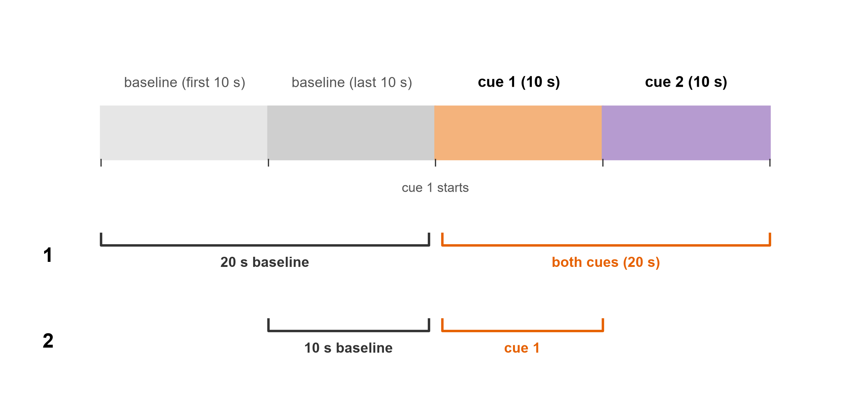
What was measured
Each trial: a baseline before cue 1, then cue 1 and cue 2.
Coherence: how much two regions’ rhythms rise and fall together. In step, it is near 1.
Comparison 1: the 20 s baseline against both cues (20 s).
When B’s timing drifts against A’s, it is near 0. In step, B’s peaks keep the same distance from A’s (the dotted lines).
Here: gamma (30–90 Hz), between every pair of 12 regions. 44 pairs had at least 4 rats on both days.

Slide 7
What was measured
Each trial: a baseline before cue 1, then cue 1 and cue 2.
Comparison 1: the 20 s baseline against both cues (20 s).
Comparison 2: the 10 s baseline against cue 1.

Slide 8
What was measured
Each trial: a baseline before cue 1, then cue 1 and cue 2.
The question: did the cues’ effect on coherence change from Precon1 to Precon4?
Comparison 1: the 20 s baseline against both cues (20 s).
Comparison 2: the 10 s baseline against cue 1.
Notes:
Coherence in each window is the mean over the session’s trials (12 to 16 a session), per rat and day.

Slide 9
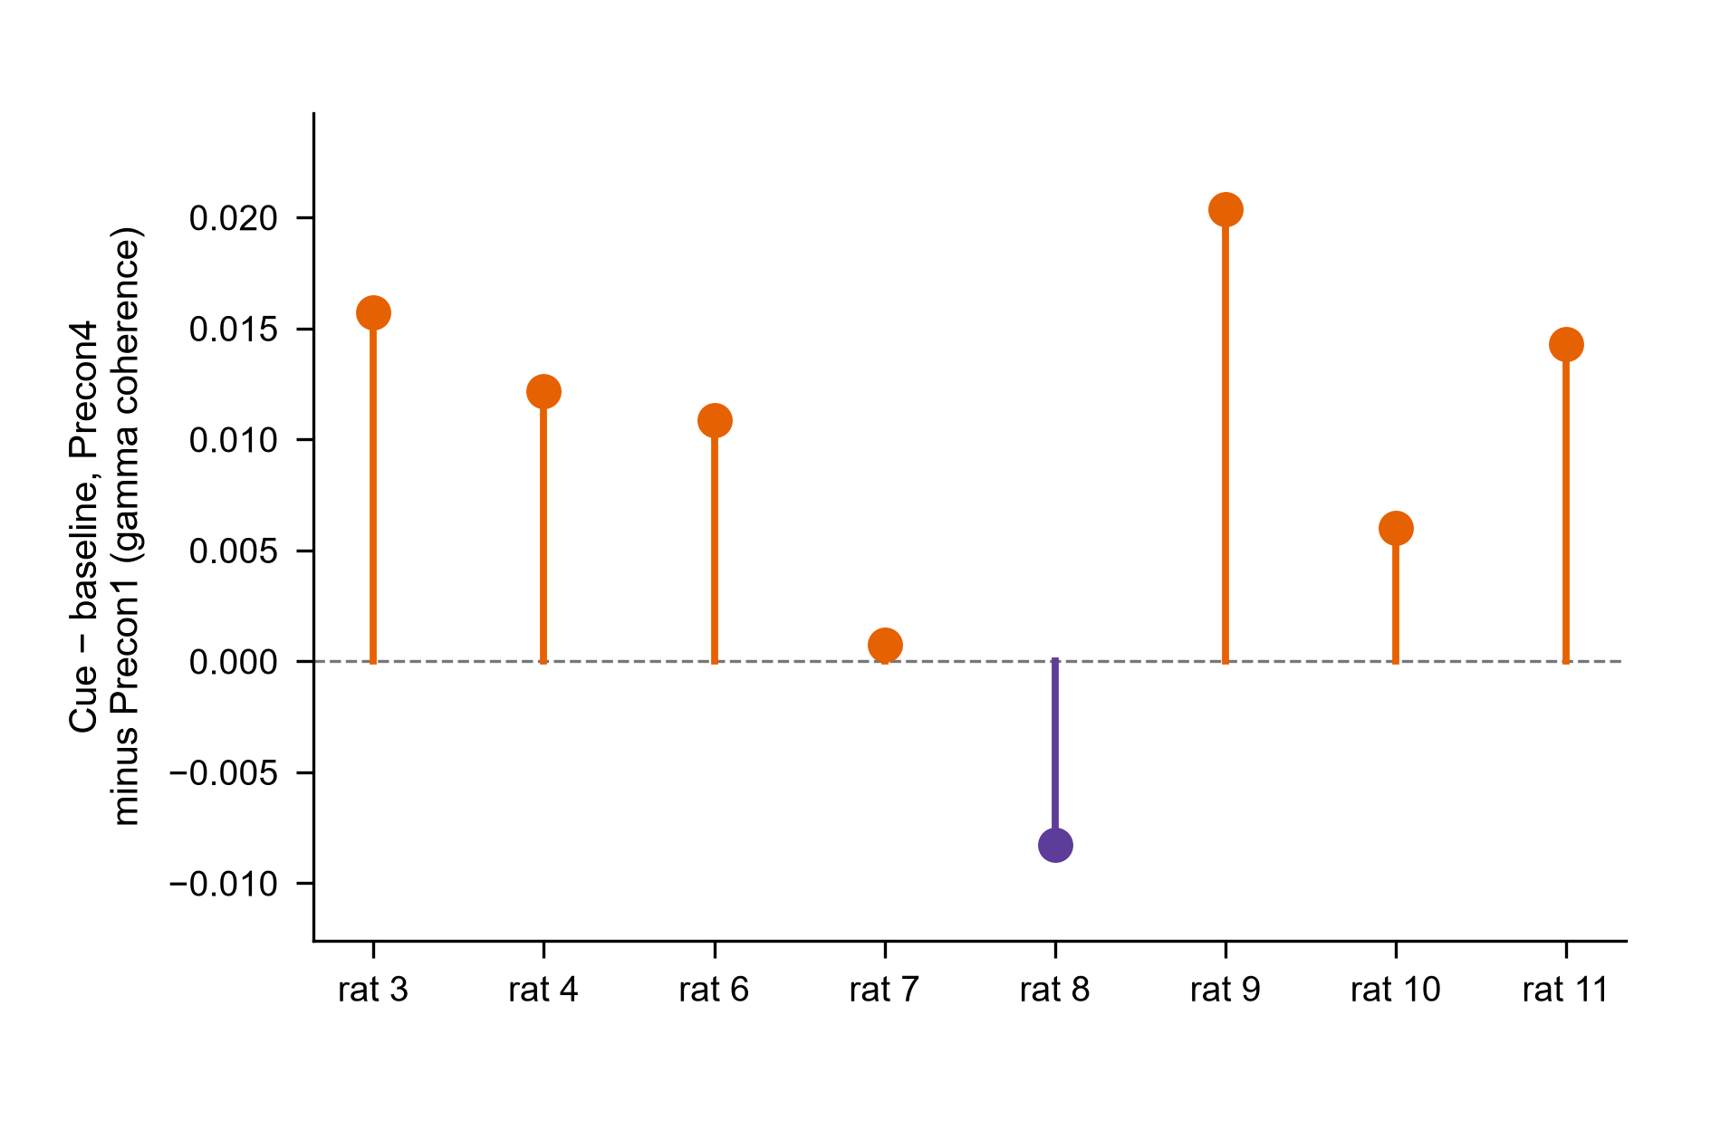
What was measured
The question: did the cues’ effect on coherence change from Precon1 to Precon4?
Each trial: a baseline before cue 1, then cue 1 and cue 2.
Comparison 1: the 20 s baseline against both cues (20 s).
Each dot is one rat (comparison 1): cue − baseline on Precon4, minus the same on Precon1, averaged over its pairs. 7 of 8 are above 0.
Comparison 2: the 10 s baseline against cue 1.

Slide 10
What was measured
The question: did the cues’ effect on coherence change from Precon1 to Precon4?
12 comparisons, each in theta and gamma. Green: unlikely to be chance (P < 0.05). Amber: a check that lit. Grey: not clear of chance, which is not the same as no change.
Each dot is one rat (comparison 1): cue − baseline on Precon4, minus the same on Precon1, averaged over its pairs. 7 of 8 are above 0.
Notes:
Per rat: the mean over its pairs of (Precon4 cue − baseline) − (Precon1 cue − baseline). A one-sample t-test of these 8 numbers: t(7) = 2.77, P = 0.028.

Slide 11
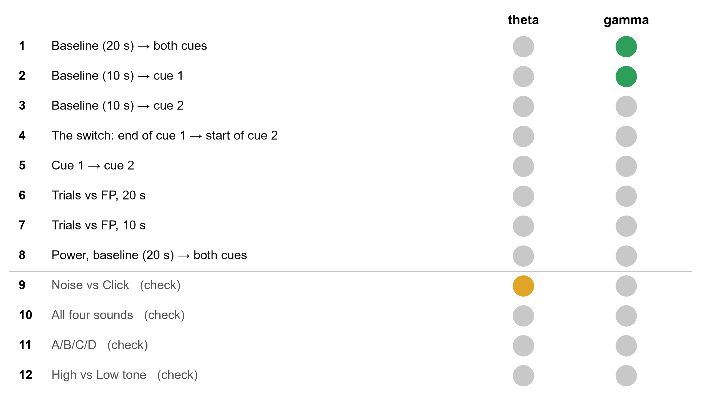
Tab 8: what lit up
12 comparisons, each in theta and gamma. Green: unlikely to be chance (P < 0.05). Amber: a check that lit. Grey: not clear of chance, which is not the same as no change.
The question: did the cues’ effect on coherence change from Precon1 to Precon4?
Each dot is one rat (comparison 1): cue − baseline on Precon4, minus the same on Precon1, averaged over its pairs. 7 of 8 are above 0.
Two lit, both in gamma: comparison 1 (P = 0.017, 7 of 8 rats the same way) and comparison 2 (P = 0.035, 6 of 8).

Slide 12
Tab 8: what lit up
12 comparisons, each in theta and gamma. Green: unlikely to be chance (P < 0.05). Amber: a check that lit. Grey: not clear of chance, which is not the same as no change.
Two lit, both in gamma: comparison 1 (P = 0.017, 7 of 8 rats the same way) and comparison 2 (P = 0.035, 6 of 8).
One check lit too: Noise vs Click in theta (P = 0.039). The checks were expected to stay dark: worth a look, not a finding.
Notes:
Mixed model, rat as the unit, Day × Phase: comparison 1 F(1, 7) = 9.57, P = 0.017; comparison 2 F(1, 7) = 6.83, P = 0.035.

Slide 13
Tab 8: what lit up
12 comparisons, each in theta and gamma. Green: unlikely to be chance (P < 0.05). Amber: a check that lit. Grey: not clear of chance, which is not the same as no change.
Two lit, both in gamma: comparison 1 (P = 0.017, 7 of 8 rats the same way) and comparison 2 (P = 0.035, 6 of 8).
One check lit too: Noise vs Click in theta (P = 0.039). The checks were expected to stay dark: worth a look, not a finding.
Nothing is corrected across the 24 lights, and each has two ways to pass. If nothing had changed anywhere, about 2 would light by chance; 3 lit.

Slide 14
Tab 8: what lit up
12 comparisons, each in theta and gamma. Green: unlikely to be chance (P < 0.05). Amber: a check that lit. Grey: not clear of chance, which is not the same as no change.
Two lit, both in gamma: comparison 1 (P = 0.017, 7 of 8 rats the same way) and comparison 2 (P = 0.035, 6 of 8).
One check lit too: Noise vs Click in theta (P = 0.039). The checks were expected to stay dark: worth a look, not a finding.
Nothing is corrected across the 24 lights, and each has two ways to pass. If nothing had changed anywhere, about 2 would light by chance; 3 lit.
Notes:
A light passes if either its Day × factor term or its Day × factor × Pair term has P < 0.05: about 24 × (1 − 0.95²) ≈ 2.3 expected by chance alone; 3 lit.

Slide 15
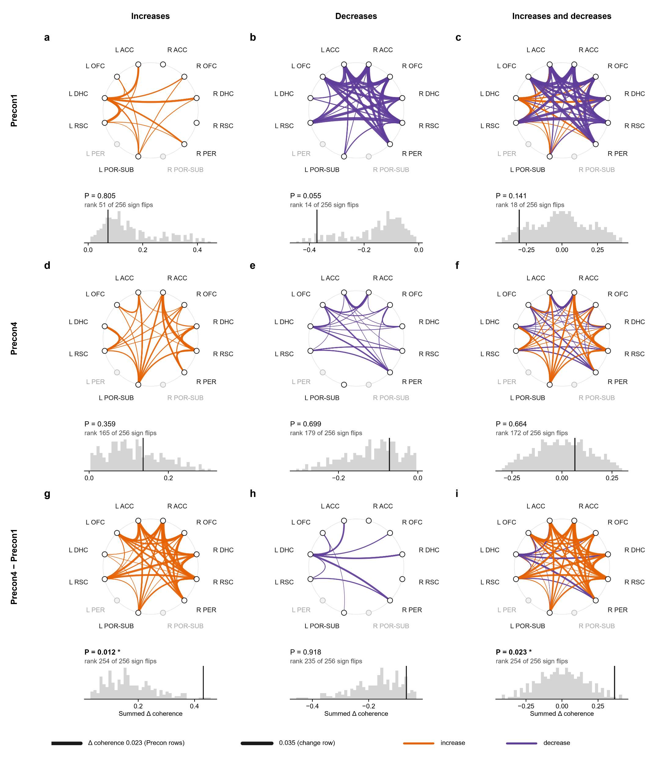
Every ring is the same 12 regions. Each line is one pair, 44 pairs in all. Grey dots: regions no pair reached with 4 rats.
12 comparisons, each in theta and gamma. Green: unlikely to be chance (P < 0.05). Amber: a check that lit. Grey: not clear of chance, which is not the same as no change.
Figure 1
Comparison 1, baseline → both cues: the whole network
Two lit, both in gamma: comparison 1 (P = 0.017, 7 of 8 rats the same way) and comparison 2 (P = 0.035, 6 of 8).
One check lit too: Noise vs Click in theta (P = 0.039). The checks were expected to stay dark: worth a look, not a finding.
Nothing is corrected across the 24 lights, and each has two ways to pass. If nothing had changed anywhere, about 2 would light by chance; 3 lit.

Slide 16
Figure 1 · baseline → both cues · gamma
Every ring is the same 12 regions. Each line is one pair, 44 pairs in all. Grey dots: regions no pair reached with 4 rats.
A line’s width is how much that pair’s coherence went from baseline to the cues, averaged over the rats. Orange: up.
Notes:
Baseline (20 s) → both cues, gamma 30–90 Hz: the connectome of the change from Baseline (20 s) to Cue 1 + Cue 2 (20 s). a–c, Precon1; d–f, Precon4; g–i, Precon4 − Precon1. Each ring holds the 12 regions (open, a region no pair reaches with at least 4 rats); each edge is one of the 44 pairs tested, curving toward the centre, its width the mean change in coherence from Baseline (20 s) to Cue 1 + Cue 2 (20 s) over the rats (Dickson 2022: 59–61 Hz notch, hanning(1024), 512 overlap, 2,048 points, averaged over 30–90 Hz without 59–61 Hz), orange for an increase and purple for a decrease. Left column, the increases; middle, the decreases; right, both. Under each ring, its statistic (the summed increases, the summed decreases, or the sum of all) against every way of flipping the sign of each rat’s change (256 sign patterns; the rat is the unit, as in the mixed model that lit tab 8’s light), the vertical line the observed value, with its rank among them and its exact P (the share at least as extreme; with 8 rats P moves in steps of 1/256, so the smallest possible is 1/256 for the increases or the decreases and 2/256 for both; increases one-sided upward, decreases downward, both two-sided; *P < 0.05, **P < 0.01, ***P < 0.001; uncorrected). n = 8 rats, 12–16 trials per session. Significant: Precon4 − Precon1, increases: P = 0.012; Precon4 − Precon1, both: P = 0.023.

Slide 17

Figure 1 · baseline → both cues · gamma
Every ring is the same 12 regions. Each line is one pair, 44 pairs in all. Grey dots: regions no pair reached with 4 rats.
A line’s width is how much that pair’s coherence went from baseline to the cues, averaged over the rats. Orange: up.
Purple: down.

Slide 18
Figure 1 · baseline → both cues · gamma
Every ring is the same 12 regions. Each line is one pair, 44 pairs in all. Grey dots: regions no pair reached with 4 rats.
A line’s width is how much that pair’s coherence went from baseline to the cues, averaged over the rats. Orange: up.
Purple: down.
Top row: Precon1. The cues lowered gamma coherence in 31 of the 44 pairs.

Slide 19
Figure 1 · baseline → both cues · gamma
Every ring is the same 12 regions. Each line is one pair, 44 pairs in all. Grey dots: regions no pair reached with 4 rats.
A line’s width is how much that pair’s coherence went from baseline to the cues, averaged over the rats. Orange: up.
Purple: down.
Top row: Precon1. The cues lowered gamma coherence in 31 of the 44 pairs.
Middle row: Precon4. About even: 23 pairs up, 21 down.

Slide 20
Figure 1 · baseline → both cues · gamma
Every ring is the same 12 regions. Each line is one pair, 44 pairs in all. Grey dots: regions no pair reached with 4 rats.
A line’s width is how much that pair’s coherence went from baseline to the cues, averaged over the rats. Orange: up.
Purple: down.
Top row: Precon1. The cues lowered gamma coherence in 31 of the 44 pairs.
Middle row: Precon4. About even: 23 pairs up, 21 down.
Bottom row: the change, Precon4 − Precon1. This is what tab 8’s light tested.

Slide 21
Figure 1 · baseline → both cues · gamma
Every ring is the same 12 regions. Each line is one pair, 44 pairs in all. Grey dots: regions no pair reached with 4 rats.
Left column: only the lines that went up. Middle: only those that went down. Right: both.
A line’s width is how much that pair’s coherence went from baseline to the cues, averaged over the rats. Orange: up.
Purple: down.
Top row: Precon1. The cues lowered gamma coherence in 31 of the 44 pairs.
Middle row: Precon4. About even: 23 pairs up, 21 down.
Bottom row: the change, Precon4 − Precon1. This is what tab 8’s light tested.

Slide 22
Figure 1 · baseline → both cues · gamma
Left column: only the lines that went up. Middle: only those that went down. Right: both.
Each ring becomes one number: its lines added up. Here the change’s increases add up to 0.43: the black line under the ring.
Every ring is the same 12 regions. Each line is one pair, 44 pairs in all. Grey dots: regions no pair reached with 4 rats.
A line’s width is how much that pair’s coherence went from baseline to the cues, averaged over the rats. Orange: up.
Purple: down.
Top row: Precon1. The cues lowered gamma coherence in 31 of the 44 pairs.
Middle row: Precon4. About even: 23 pairs up, 21 down.
Bottom row: the change, Precon4 − Precon1. This is what tab 8’s light tested.

Slide 23

Figure 1 · baseline → both cues · gamma
Each ring becomes one number: its lines added up. Here the change’s increases add up to 0.43: the black line under the ring.
Left column: only the lines that went up. Middle: only those that went down. Right: both.
The test: if the cues’ effect were the same on both days, each rat’s change could as well point the other way. Flip the rats’ signs every way (256 for 8 rats) and add up again each time: those sums are the grey hill.

Slide 24
Figure 1 · baseline → both cues · gamma
Each ring becomes one number: its lines added up. Here the change’s increases add up to 0.43: the black line under the ring.
The test: if the cues’ effect were the same on both days, each rat’s change could as well point the other way. Flip the rats’ signs every way (256 for 8 rats) and add up again each time: those sums are the grey hill.
The black line is the real sum. Only 3 of the 256 sums reach it (itself included): P = 0.012.
Notes:
Exact sign-flip test, the rat as the unit (as the mixed model behind tab 8's light). P is the share of the 256 patterns at least as extreme, the real one included.

Slide 25
Figure 1 · baseline → both cues · gamma
Each ring becomes one number: its lines added up. Here the change’s increases add up to 0.43: the black line under the ring.
The test: if the cues’ effect were the same on both days, each rat’s change could as well point the other way. Flip the rats’ signs every way (256 for 8 rats) and add up again each time: those sums are the grey hill.
The black line is the real sum. Only 3 of the 256 sums reach it (itself included): P = 0.012.
Ups and downs together: P = 0.023, in line with tab 8’s light (P = 0.017).
Notes:
Rank 254 of 256.

Slide 26
Figure 1 · baseline → both cues · gamma
Each ring becomes one number: its lines added up. Here the change’s increases add up to 0.43: the black line under the ring.
The test: if the cues’ effect were the same on both days, each rat’s change could as well point the other way. Flip the rats’ signs every way (256 for 8 rats) and add up again each time: those sums are the grey hill.
The black line is the real sum. Only 3 of the 256 sums reach it (itself included): P = 0.012.
Ups and downs together: P = 0.023, in line with tab 8’s light (P = 0.017).
Neither day passes on its own (Precon1 P = 0.055 at best, Precon4 P = 0.359): it is the change between them.

Slide 27
Figure 1 · baseline → both cues · gamma
Each ring becomes one number: its lines added up. Here the change’s increases add up to 0.43: the black line under the ring.
Same ring, a second test (the toggle on tab 9): in every session, each trial’s baseline and cue swapped at random, 10,000 times. Single trials vary a lot, so the hill is much wider: P = 0.187 (the rats’ test: P = 0.023).
The test: if the cues’ effect were the same on both days, each rat’s change could as well point the other way. Flip the rats’ signs every way (256 for 8 rats) and add up again each time: those sums are the grey hill.
The black line is the real sum. Only 3 of the 256 sums reach it (itself included): P = 0.012.
Ups and downs together: P = 0.023, in line with tab 8’s light (P = 0.017).
Neither day passes on its own (Precon1 P = 0.055 at best, Precon4 P = 0.359): it is the change between them.

Slide 28
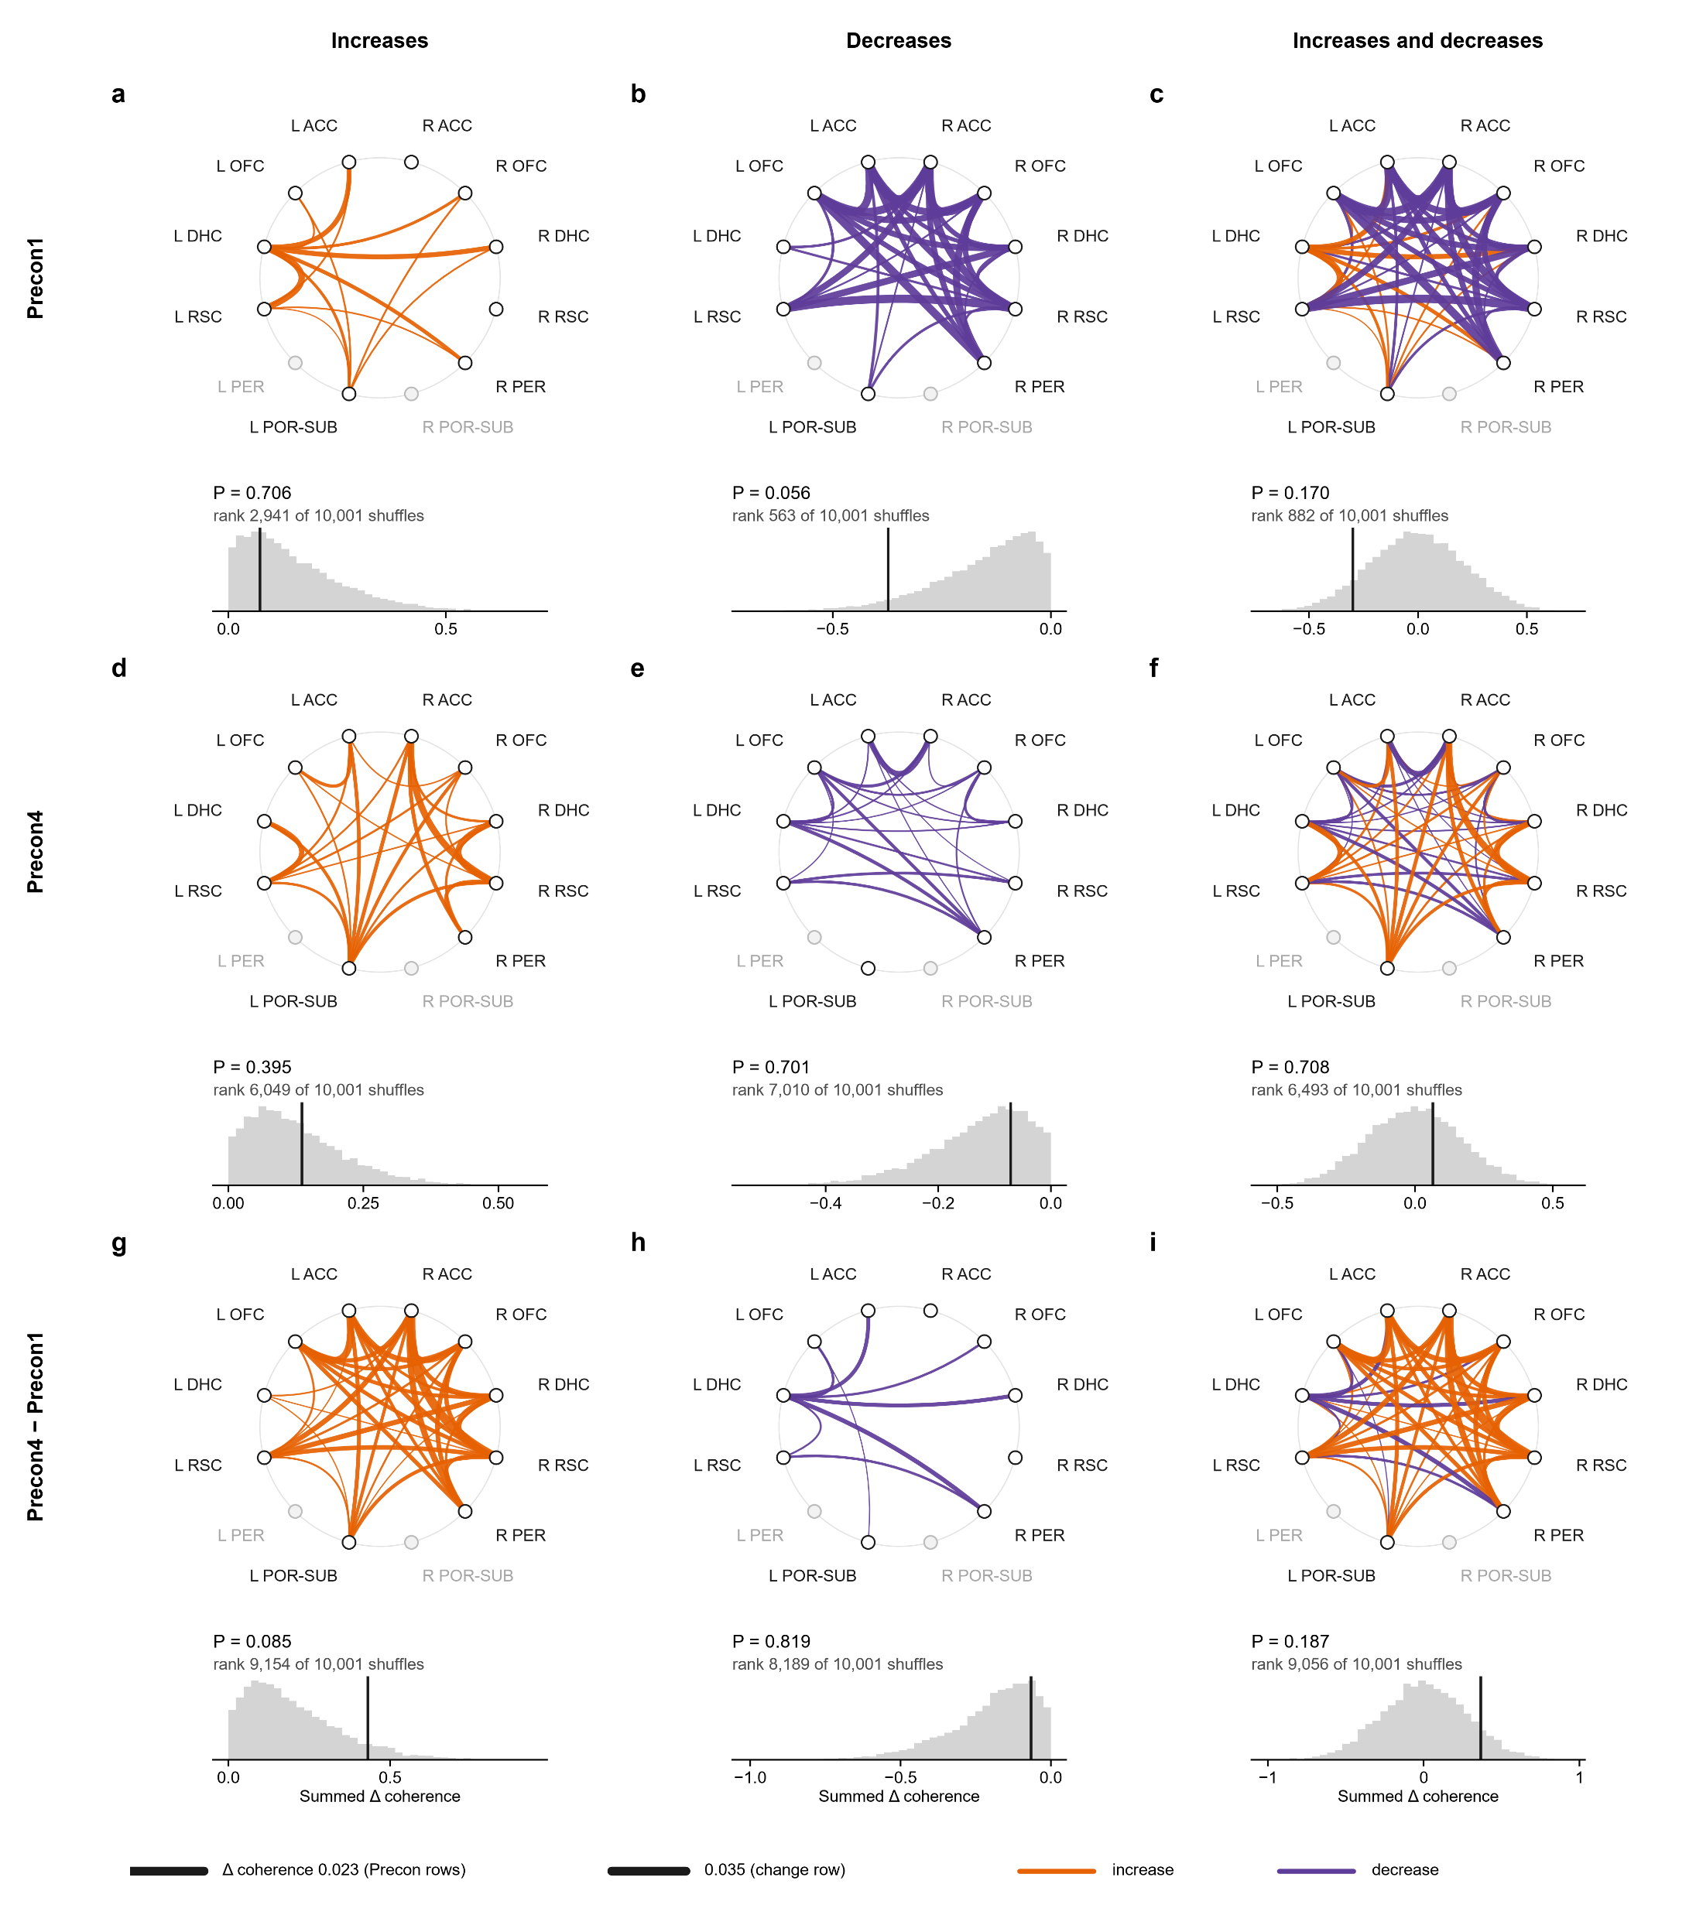
Figure 1 · baseline → both cues · gamma
Same ring, a second test (the toggle on tab 9): in every session, each trial’s baseline and cue swapped at random, 10,000 times. Single trials vary a lot, so the hill is much wider: P = 0.187 (the rats’ test: P = 0.023).
A third test, FP: the same rats in FP1 and FP2, with no cues. Fake trials at random moments, measured as real ones are; in each of 10,000 sets every session gets as many as it had real trials, losing the same windows its real trials lost.
Each ring becomes one number: its lines added up. Here the change’s increases add up to 0.43: the black line under the ring.
The test: if the cues’ effect were the same on both days, each rat’s change could as well point the other way. Flip the rats’ signs every way (256 for 8 rats) and add up again each time: those sums are the grey hill.
The black line is the real sum. Only 3 of the 256 sums reach it (itself included): P = 0.012.
Ups and downs together: P = 0.023, in line with tab 8’s light (P = 0.017).
Neither day passes on its own (Precon1 P = 0.055 at best, Precon4 P = 0.359): it is the change between them.
Notes:
Trial-to-trial noise inside a session is about 1.7 times wider than the spread between rats.

Slide 29
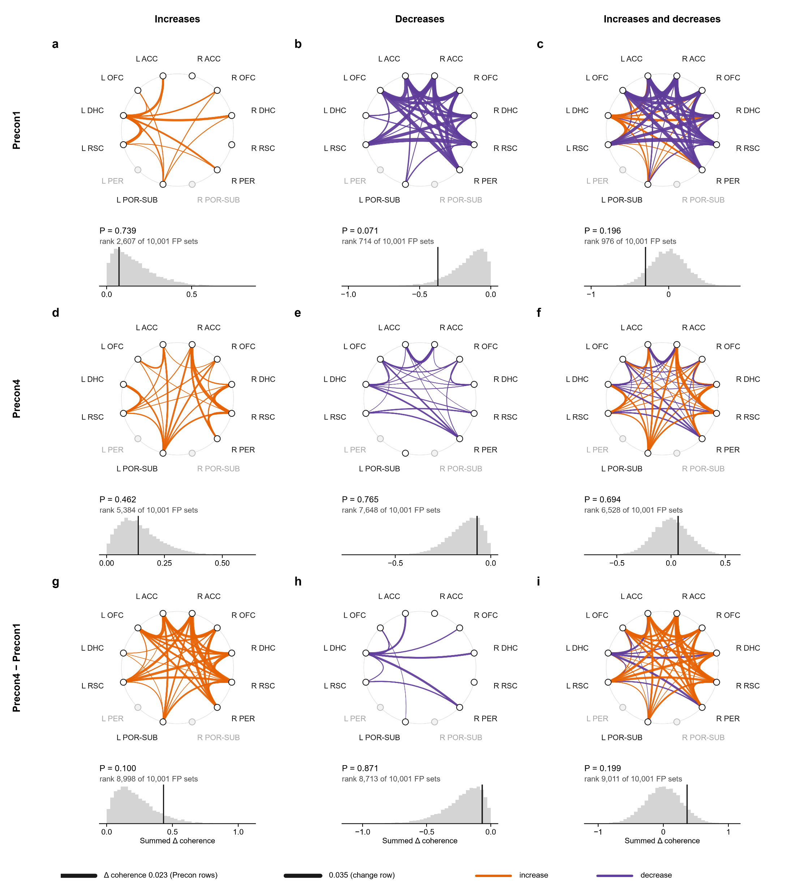
Figure 1 · baseline → both cues · gamma
A third test, FP: the same rats in FP1 and FP2, with no cues. Fake trials at random moments, measured as real ones are; in each of 10,000 sets every session gets as many as it had real trials, losing the same windows its real trials lost.
Same ring, a second test (the toggle on tab 9): in every session, each trial’s baseline and cue swapped at random, 10,000 times. Single trials vary a lot, so the hill is much wider: P = 0.187 (the rats’ test: P = 0.023).
Against FP, Figure 1’s change: P = 0.199 (increases P = 0.100). It does not stand out of what the rats do with no cues.
Notes:
A fake cue onset every 10 s of FP1 and FP2 (1,017 fake trials in all), the trial's own windows round it, measured with the same wires, clipping and measures; each set draws each session's fake trials at random, with replacement.

Slide 30
Figure 1 · baseline → both cues · gamma
A third test, FP: the same rats in FP1 and FP2, with no cues. Fake trials at random moments, measured as real ones are; in each of 10,000 sets every session gets as many as it had real trials, losing the same windows its real trials lost.
So: the rats moved together, the test that matches tab 8’s light, but neither the trial shuffle nor FP confirms it. Figure 1 is a lead, not a finding.
Against FP, Figure 1’s change: P = 0.199 (increases P = 0.100). It does not stand out of what the rats do with no cues.

Slide 31
Figure 1 · baseline → both cues · gamma
So: the rats moved together, the test that matches tab 8’s light, but neither the trial shuffle nor FP confirms it. Figure 1 is a lead, not a finding.
A third test, FP: the same rats in FP1 and FP2, with no cues. Fake trials at random moments, measured as real ones are; in each of 10,000 sets every session gets as many as it had real trials, losing the same windows its real trials lost.
Against FP, Figure 1’s change: P = 0.199 (increases P = 0.100). It does not stand out of what the rats do with no cues.

Slide 32
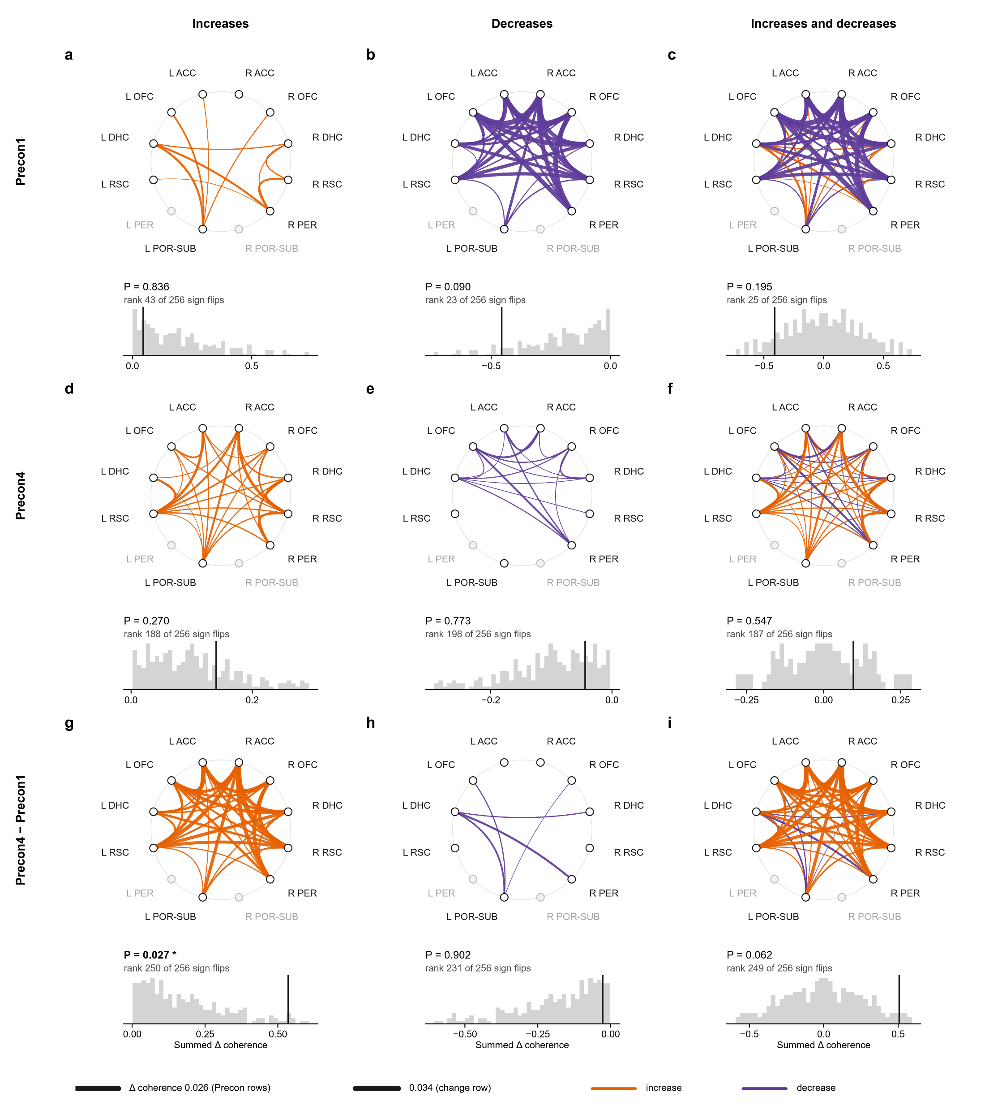
Same layout, comparison 2: the 10 s baseline against cue 1.
So: the rats moved together, the test that matches tab 8’s light, but neither the trial shuffle nor FP confirms it. Figure 1 is a lead, not a finding.
Figure 2
Comparison 2, baseline → cue 1: the whole network

Slide 33
Figure 2 · baseline → cue 1 · gamma
Same layout, comparison 2: the 10 s baseline against cue 1.
The change’s increases: only 7 of 256 sums reach it: P = 0.027. The trial shuffle agrees (P = 0.030), and so does FP (P = 0.037): the one network result that passes every test.

Slide 34

Figure 2 · baseline → cue 1 · gamma
Same layout, comparison 2: the 10 s baseline against cue 1.
The change’s increases: only 7 of 256 sums reach it: P = 0.027. The trial shuffle agrees (P = 0.030), and so does FP (P = 0.037): the one network result that passes every test.
Ups and downs together: rats P = 0.062, trials P = 0.058, FP P = 0.074.

Slide 35
Figure 2 · baseline → cue 1 · gamma
Same layout, comparison 2: the 10 s baseline against cue 1.
One ring splits the other way: on Precon1 alone, the decreases pass the trial shuffle (P = 0.039) and FP (P = 0.030) but not the rats’ test (P = 0.090). It is one day, not the change, so it does not answer the question.
The change’s increases: only 7 of 256 sums reach it: P = 0.027. The trial shuffle agrees (P = 0.030), and so does FP (P = 0.037): the one network result that passes every test.
Ups and downs together: rats P = 0.062, trials P = 0.058, FP P = 0.074.

Slide 36
Figure 2 · baseline → cue 1 · gamma
One ring splits the other way: on Precon1 alone, the decreases pass the trial shuffle (P = 0.039) and FP (P = 0.030) but not the rats’ test (P = 0.090). It is one day, not the change, so it does not answer the question.
Then tab 8 looked closer at single pairs inside comparisons 1 and 2, with four kinds of extra test.
Same layout, comparison 2: the 10 s baseline against cue 1.
The change’s increases: only 7 of 256 sums reach it: P = 0.027. The trial shuffle agrees (P = 0.030), and so does FP (P = 0.037): the one network result that passes every test.
Ups and downs together: rats P = 0.062, trials P = 0.058, FP P = 0.074.

Slide 37
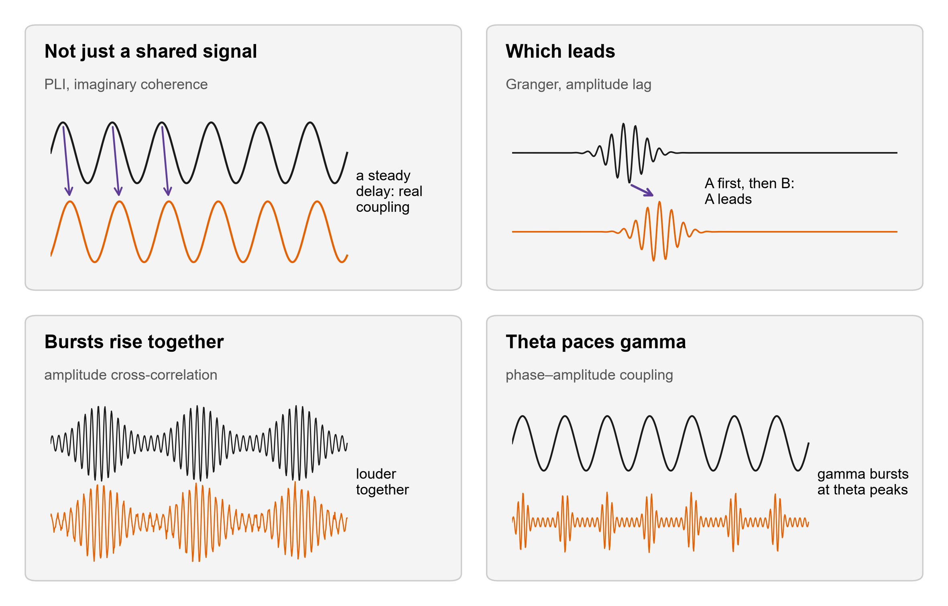
The follow-ups
Then tab 8 looked closer at single pairs inside comparisons 1 and 2, with four kinds of extra test.
One ring splits the other way: on Precon1 alone, the decreases pass the trial shuffle (P = 0.039) and FP (P = 0.030) but not the rats’ test (P = 0.090). It is one day, not the change, so it does not answer the question.
Not just a shared signal: two wires can look coherent because they pick up the same source. PLI and imaginary coherence count only coupling with a delay: PLI asks how steadily one rhythm runs ahead, imaginary coherence also weighs how strongly.

Slide 38
The follow-ups
Then tab 8 looked closer at single pairs inside comparisons 1 and 2, with four kinds of extra test.
Which leads: Granger asks if one region’s past predicts the other’s future; the lag asks whose gamma bursts come first.
Not just a shared signal: two wires can look coherent because they pick up the same source. PLI and imaginary coherence count only coupling with a delay: PLI asks how steadily one rhythm runs ahead, imaginary coherence also weighs how strongly.

Slide 39
The follow-ups
Which leads: Granger asks if one region’s past predicts the other’s future; the lag asks whose gamma bursts come first.
Then tab 8 looked closer at single pairs inside comparisons 1 and 2, with four kinds of extra test.
Not just a shared signal: two wires can look coherent because they pick up the same source. PLI and imaginary coherence count only coupling with a delay: PLI asks how steadily one rhythm runs ahead, imaginary coherence also weighs how strongly.
Bursts rise together: do the two regions’ gamma get loud at the same moments?

Slide 40
The follow-ups
Which leads: Granger asks if one region’s past predicts the other’s future; the lag asks whose gamma bursts come first.
Theta paces gamma: do gamma bursts in one region ride the theta cycle of another (or its own)?
Bursts rise together: do the two regions’ gamma get loud at the same moments?

Slide 41
The follow-ups
Theta paces gamma: do gamma bursts in one region ride the theta cycle of another (or its own)?
How to read a follow-up figure. a: the pair, on the same ring (an arrow when a direction was measured).
Which leads: Granger asks if one region’s past predicts the other’s future; the lag asks whose gamma bursts come first.
Bursts rise together: do the two regions’ gamma get loud at the same moments?

Slide 42
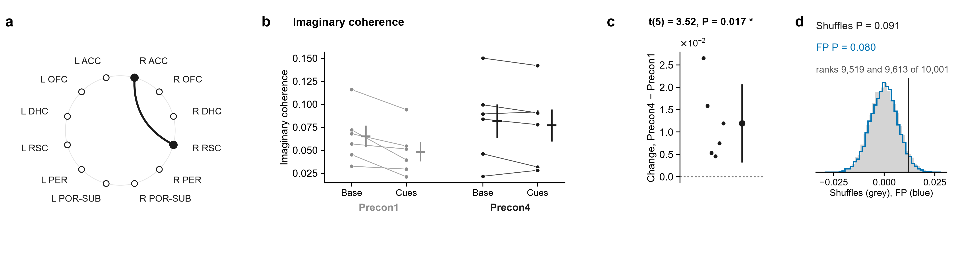
1.1 · R ACC – R RSC · Not just a shared signal
How to read a follow-up figure. a: the pair, on the same ring (an arrow when a direction was measured).
Theta paces gamma: do gamma bursts in one region ride the theta cycle of another (or its own)?
b: each rat’s baseline and cue, Precon1 in grey and Precon4 in black.
Notes:
Baseline (20 s) → both cues, gamma, R ACC – R RSC: not volume conduction. a, the pair on the ring of regions. Then, for each measure: its value for each rat at Baseline (20 s) and Cue 1 + Cue 2 (20 s) on Precon1 (grey) and Precon4 (black), each rat's two windows joined, the mean ± s.e.m. beside them; each rat's change between the days, (Precon4 Cue 1 + Cue 2 (20 s) − Baseline (20 s)) − (Precon1 Cue 1 + Cue 2 (20 s) − Baseline (20 s)), with the mean ± 95% confidence interval; and that mean against 10,000 shuffles in which each session's trials had their two windows swapped at random (grey) and against 10,000 sets of fake trials from the same rats' FP1 and FP2, where there were no cues, each session as many as it had real trials, in random order, losing the windows its real trials lost (blue). The pair was followed up because its own change in coherence had P < 0.05 (uncorrected; no pair survives correction on its own), and of the measures run on it these are the ones whose t-test had P < 0.05: they are leads, chosen by that test. Imaginary coherence: t(5) = 3.52, P = 0.017 (one-sample t-test of each rat's change, uncorrected); within-session shuffles P = 0.091, rank 9,519 of 10,001; FP intervals P = 0.080, rank 9,613 of 10,001.

Slide 43
1.1 · R ACC – R RSC · Not just a shared signal
How to read a follow-up figure. a: the pair, on the same ring (an arrow when a direction was measured).
b: each rat’s baseline and cue, Precon1 in grey and Precon4 in black.
c: each rat’s change, Precon4 − Precon1, with the mean and its 95% range. The t-test asks if the mean is away from 0.

Slide 44
1.1 · R ACC – R RSC · Not just a shared signal
How to read a follow-up figure. a: the pair, on the same ring (an arrow when a direction was measured).
b: each rat’s baseline and cue, Precon1 in grey and Precon4 in black.
c: each rat’s change, Precon4 − Precon1, with the mean and its 95% range. The t-test asks if the mean is away from 0.
d: the same change against two second opinions: 10,000 within-session shuffles (grey) and 10,000 sets of fake trials from FP (blue).

Slide 45
1.1 · R ACC – R RSC · Not just a shared signal
How to read a follow-up figure. a: the pair, on the same ring (an arrow when a direction was measured).
Tab 8 ran 190 of these t-tests (19 pairs × 10 measures); 21 passed, where about 10 would by chance. Those 21 are the measures in these 20 figures.
b: each rat’s baseline and cue, Precon1 in grey and Precon4 in black.
c: each rat’s change, Precon4 − Precon1, with the mean and its 95% range. The t-test asks if the mean is away from 0.
d: the same change against two second opinions: 10,000 within-session shuffles (grey) and 10,000 sets of fake trials from FP (blue).

Slide 46
1.1 · R ACC – R RSC · Not just a shared signal
Tab 8 ran 190 of these t-tests (19 pairs × 10 measures); 21 passed, where about 10 would by chance. Those 21 are the measures in these 20 figures.
Coupling with a real delay, R ACC with R RSC (imaginary coherence): cue − baseline was higher on Precon4 than on Precon1.
How to read a follow-up figure. a: the pair, on the same ring (an arrow when a direction was measured).
b: each rat’s baseline and cue, Precon1 in grey and Precon4 in black.
c: each rat’s change, Precon4 − Precon1, with the mean and its 95% range. The t-test asks if the mean is away from 0.
d: the same change against two second opinions: 10,000 within-session shuffles (grey) and 10,000 sets of fake trials from FP (blue).

Slide 47
1.1 · R ACC – R RSC · Not just a shared signal
Coupling with a real delay, R ACC with R RSC (imaginary coherence): cue − baseline was higher on Precon4 than on Precon1.
Tab 8 ran 190 of these t-tests (19 pairs × 10 measures); 21 passed, where about 10 would by chance. Those 21 are the measures in these 20 figures.
t-test P = 0.017 (6 rats). Shuffles P = 0.091. FP P = 0.080. Neither second opinion agrees: a weaker lead.
Notes:
Baseline (20 s) → both cues, gamma, R ACC – R RSC: not volume conduction. a, the pair on the ring of regions. Then, for each measure: its value for each rat at Baseline (20 s) and Cue 1 + Cue 2 (20 s) on Precon1 (grey) and Precon4 (black), each rat's two windows joined, the mean ± s.e.m. beside them; each rat's change between the days, (Precon4 Cue 1 + Cue 2 (20 s) − Baseline (20 s)) − (Precon1 Cue 1 + Cue 2 (20 s) − Baseline (20 s)), with the mean ± 95% confidence interval; and that mean against 10,000 shuffles in which each session's trials had their two windows swapped at random (grey) and against 10,000 sets of fake trials from the same rats' FP1 and FP2, where there were no cues, each session as many as it had real trials, in random order, losing the windows its real trials lost (blue). The pair was followed up because its own change in coherence had P < 0.05 (uncorrected; no pair survives correction on its own), and of the measures run on it these are the ones whose t-test had P < 0.05: they are leads, chosen by that test. Imaginary coherence: t(5) = 3.52, P = 0.017 (one-sample t-test of each rat's change, uncorrected); within-session shuffles P = 0.091, rank 9,519 of 10,001; FP intervals P = 0.080, rank 9,613 of 10,001.

Slide 48
1.1 · R ACC – R RSC · Not just a shared signal
Coupling with a real delay, R ACC with R RSC (imaginary coherence): cue − baseline was higher on Precon4 than on Precon1.
R RSC predicting R ACC (Granger R RSC → R ACC): cue − baseline was higher on Precon4 than on Precon1.
t-test P = 0.017 (6 rats). Shuffles P = 0.091. FP P = 0.080. Neither second opinion agrees: a weaker lead.
Notes:
t(5) = 3.52, P = 0.017; mean change 0.01195. Shuffles: rank 9519 of 10001, P = 0.091. FP: rank 9613 of 10001, P = 0.080.

Slide 49
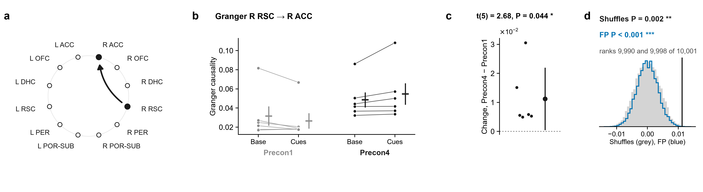
1.2 · R ACC – R RSC · Which leads
R RSC predicting R ACC (Granger R RSC → R ACC): cue − baseline was higher on Precon4 than on Precon1.
Coupling with a real delay, R ACC with R RSC (imaginary coherence): cue − baseline was higher on Precon4 than on Precon1.
t-test P = 0.044 (6 rats). Shuffles P = 0.002. FP P < 0.001. Both second opinions agree: a stronger lead.
t-test P = 0.017 (6 rats). Shuffles P = 0.091. FP P = 0.080. Neither second opinion agrees: a weaker lead.
Notes:
Baseline (20 s) → both cues, gamma, R ACC – R RSC: direction. a, the pair on the ring of regions (the arrow, the direction measured). Then, for each measure: its value for each rat at Baseline (20 s) and Cue 1 + Cue 2 (20 s) on Precon1 (grey) and Precon4 (black), each rat's two windows joined, the mean ± s.e.m. beside them; each rat's change between the days, (Precon4 Cue 1 + Cue 2 (20 s) − Baseline (20 s)) − (Precon1 Cue 1 + Cue 2 (20 s) − Baseline (20 s)), with the mean ± 95% confidence interval; and that mean against 10,000 shuffles in which each session's trials had their two windows swapped at random (grey) and against 10,000 sets of fake trials from the same rats' FP1 and FP2, where there were no cues, each session as many as it had real trials, in random order, losing the windows its real trials lost (blue). The pair was followed up because its own change in coherence had P < 0.05 (uncorrected; no pair survives correction on its own), and of the measures run on it these are the ones whose t-test had P < 0.05: they are leads, chosen by that test. Granger R RSC → R ACC: t(5) = 2.68, P = 0.044 (one-sample t-test of each rat's change, uncorrected); within-session shuffles P = 0.002, rank 9,990 of 10,001; FP intervals P < 0.001, rank 9,998 of 10,001.

Slide 50
1.2 · R ACC – R RSC · Which leads
R RSC predicting R ACC (Granger R RSC → R ACC): cue − baseline was higher on Precon4 than on Precon1.
Theta in R RSC pacing gamma in R ACC (PAC): cue − baseline was lower on Precon4 than on Precon1.
t-test P = 0.044 (6 rats). Shuffles P = 0.002. FP P < 0.001. Both second opinions agree: a stronger lead.
Notes:
t(5) = 2.68, P = 0.044; mean change 0.01122. Shuffles: rank 9990 of 10001, P = 0.002. FP: rank 9998 of 10001, P < 0.001.

Slide 51
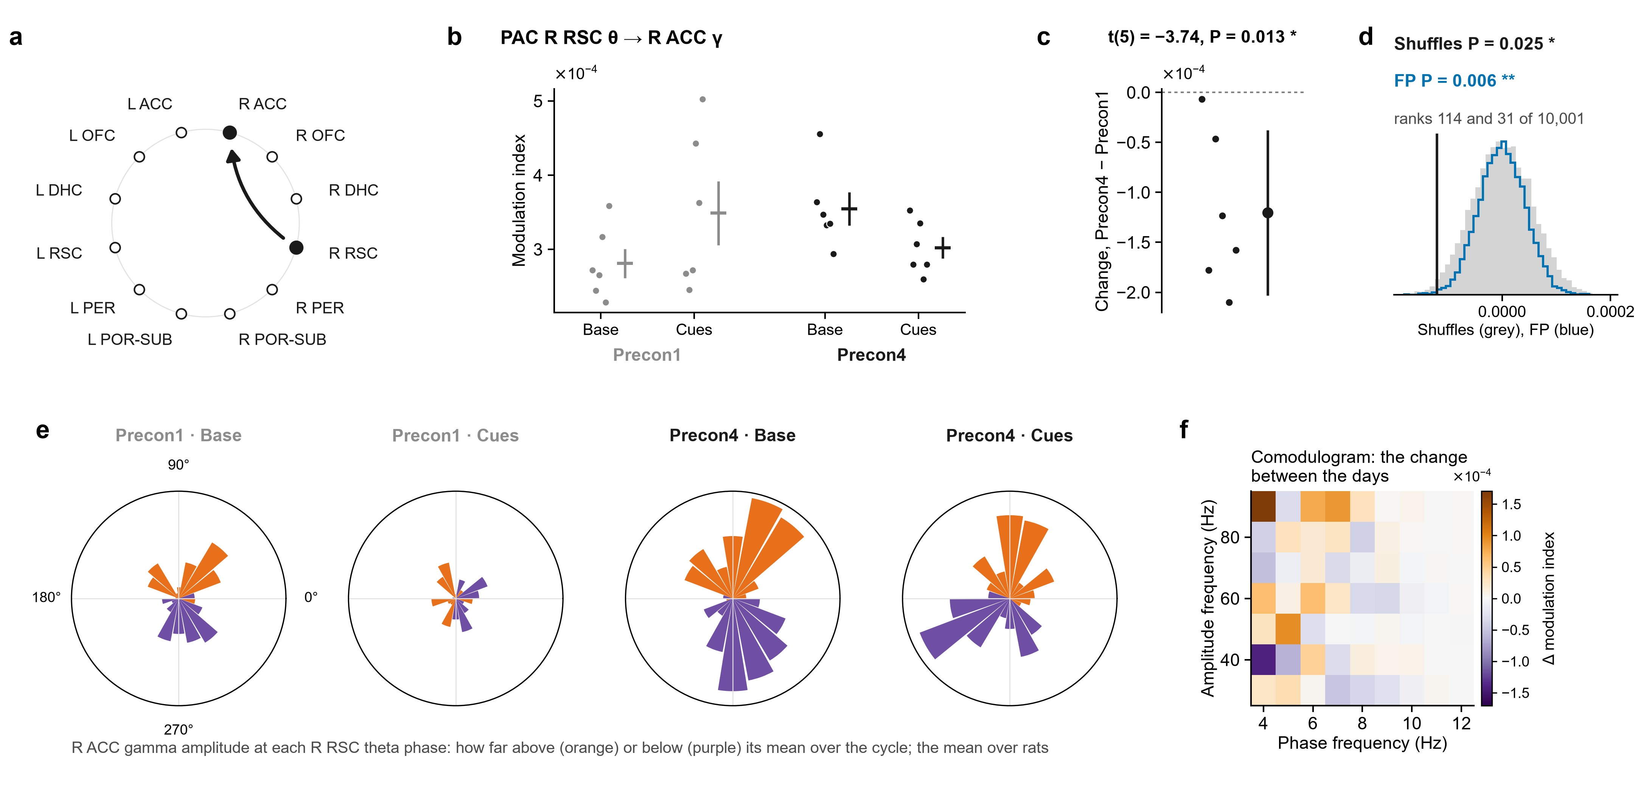
1.3 · R ACC – R RSC · Theta paces gamma
Theta in R RSC pacing gamma in R ACC (PAC): cue − baseline was lower on Precon4 than on Precon1.
R RSC predicting R ACC (Granger R RSC → R ACC): cue − baseline was higher on Precon4 than on Precon1.
t-test P = 0.013 (6 rats). Shuffles P = 0.025. FP P = 0.006. Both second opinions agree: a stronger lead.
t-test P = 0.044 (6 rats). Shuffles P = 0.002. FP P < 0.001. Both second opinions agree: a stronger lead.
Notes:
Baseline (20 s) → both cues, gamma, R ACC – R RSC: phase–amplitude coupling. a, the pair on the ring of regions (the arrow, the direction measured). Then, for each measure: its value for each rat at Baseline (20 s) and Cue 1 + Cue 2 (20 s) on Precon1 (grey) and Precon4 (black), each rat's values as dots (PAC is never drawn as lines), the mean ± s.e.m. beside them; each rat's change between the days, (Precon4 Cue 1 + Cue 2 (20 s) − Baseline (20 s)) − (Precon1 Cue 1 + Cue 2 (20 s) − Baseline (20 s)), with the mean ± 95% confidence interval; and that mean against 10,000 shuffles in which each session's trials had their two windows swapped at random (grey) and against 10,000 sets of fake trials from the same rats' FP1 and FP2, where there were no cues, each session as many as it had real trials, in random order, losing the windows its real trials lost (blue). The pair was followed up because its own change in coherence had P < 0.05 (uncorrected; no pair survives correction on its own), and of the measures run on it these are the ones whose t-test had P < 0.05: they are leads, chosen by that test. PAC R RSC θ → R ACC γ: t(5) = −3.74, P = 0.013 (one-sample t-test of each rat's change, uncorrected); within-session shuffles P = 0.025, rank 114 of 10,001; FP intervals P = 0.006, rank 31 of 10,001.

Slide 52
1.3 · R ACC – R RSC · Theta paces gamma
Theta in R RSC pacing gamma in R ACC (PAC): cue − baseline was lower on Precon4 than on Precon1.
The roses: R ACC gamma around the R RSC theta cycle, averaged over rats. Orange: louder at that phase than its average over the cycle; purple: quieter.
t-test P = 0.013 (6 rats). Shuffles P = 0.025. FP P = 0.006. Both second opinions agree: a stronger lead.
Notes:
t(5) = -3.74, P = 0.013; mean change -0.0001204. Shuffles: rank 114 of 10001, P = 0.025. FP: rank 31 of 10001, P = 0.006.

Slide 53
1.3 · R ACC – R RSC · Theta paces gamma
The roses: R ACC gamma around the R RSC theta cycle, averaged over rats. Orange: louder at that phase than its average over the cycle; purple: quieter.
Theta in R RSC pacing gamma in R ACC (PAC): cue − baseline was lower on Precon4 than on Precon1.
t-test P = 0.013 (6 rats). Shuffles P = 0.025. FP P = 0.006. Both second opinions agree: a stronger lead.
Precon1 on the left, Precon4 on the right; baseline, then the cue. Rats that prefer different phases cancel, so a rose shows where in the cycle, not how much: b and c are what was tested.
Notes:
Mean over rats of each rat's normalised gamma amplitude in 18 theta-phase bins, read from the recordings (the VACC's copies) through tab 8's own wires; the four roses share one scale.

Slide 54
1.3 · R ACC – R RSC · Theta paces gamma
The roses: R ACC gamma around the R RSC theta cycle, averaged over rats. Orange: louder at that phase than its average over the cycle; purple: quieter.
Precon1 on the left, Precon4 on the right; baseline, then the cue. Rats that prefer different phases cancel, so a rose shows where in the cycle, not how much: b and c are what was tested.
The comodulogram: the same change (cue − baseline, Precon4 minus Precon1) split into narrow theta bands (across) and gamma bands (up). Orange: the cue raised coupling more on Precon4; purple: less. A map, not the test: c is the result.

Slide 55
1.3 · R ACC – R RSC · Theta paces gamma
The roses: R ACC gamma around the R RSC theta cycle, averaged over rats. Orange: louder at that phase than its average over the cycle; purple: quieter.
R DHC and L RSC gamma bursts rising together (amplitude correlation): cue − baseline was higher on Precon4 than on Precon1.
Precon1 on the left, Precon4 on the right; baseline, then the cue. Rats that prefer different phases cancel, so a rose shows where in the cycle, not how much: b and c are what was tested.
The comodulogram: the same change (cue − baseline, Precon4 minus Precon1) split into narrow theta bands (across) and gamma bands (up). Orange: the cue raised coupling more on Precon4; purple: less. A map, not the test: c is the result.

Slide 56
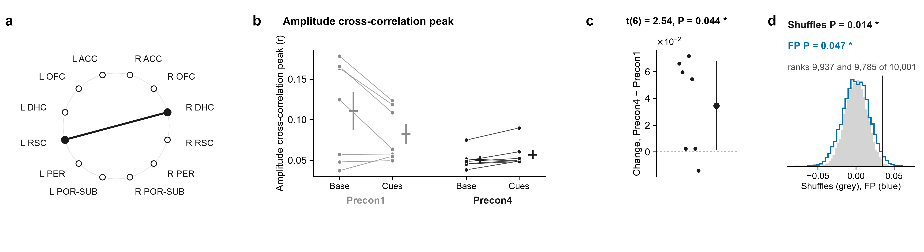
1.4 · R DHC – L RSC · Bursts rise together
R DHC and L RSC gamma bursts rising together (amplitude correlation): cue − baseline was higher on Precon4 than on Precon1.
The roses: R ACC gamma around the R RSC theta cycle, averaged over rats. Orange: louder at that phase than its average over the cycle; purple: quieter.
t-test P = 0.044 (7 rats). Shuffles P = 0.014. FP P = 0.047. Both second opinions agree: a stronger lead.
Precon1 on the left, Precon4 on the right; baseline, then the cue. Rats that prefer different phases cancel, so a rose shows where in the cycle, not how much: b and c are what was tested.
The comodulogram: the same change (cue − baseline, Precon4 minus Precon1) split into narrow theta bands (across) and gamma bands (up). Orange: the cue raised coupling more on Precon4; purple: less. A map, not the test: c is the result.
Notes:
Baseline (20 s) → both cues, gamma, R DHC – L RSC: amplitudes together. a, the pair on the ring of regions. Then, for each measure: its value for each rat at Baseline (20 s) and Cue 1 + Cue 2 (20 s) on Precon1 (grey) and Precon4 (black), each rat's two windows joined, the mean ± s.e.m. beside them; each rat's change between the days, (Precon4 Cue 1 + Cue 2 (20 s) − Baseline (20 s)) − (Precon1 Cue 1 + Cue 2 (20 s) − Baseline (20 s)), with the mean ± 95% confidence interval; and that mean against 10,000 shuffles in which each session's trials had their two windows swapped at random (grey) and against 10,000 sets of fake trials from the same rats' FP1 and FP2, where there were no cues, each session as many as it had real trials, in random order, losing the windows its real trials lost (blue). The pair was followed up because its own change in coherence had P < 0.05 (uncorrected; no pair survives correction on its own), and of the measures run on it these are the ones whose t-test had P < 0.05: they are leads, chosen by that test. Amplitude cross-correlation peak: t(6) = 2.54, P = 0.044 (one-sample t-test of each rat's change, uncorrected); within-session shuffles P = 0.014, rank 9,937 of 10,001; FP intervals P = 0.047, rank 9,785 of 10,001.

Slide 57
1.4 · R DHC – L RSC · Bursts rise together
R DHC and L RSC gamma bursts rising together (amplitude correlation): cue − baseline was higher on Precon4 than on Precon1.
R RSC predicting L POR-SUB (Granger R RSC → L POR-SUB): cue − baseline was higher on Precon4 than on Precon1.
t-test P = 0.044 (7 rats). Shuffles P = 0.014. FP P = 0.047. Both second opinions agree: a stronger lead.
Notes:
t(6) = 2.54, P = 0.044; mean change 0.03468. Shuffles: rank 9937 of 10001, P = 0.014. FP: rank 9785 of 10001, P = 0.047.

Slide 58
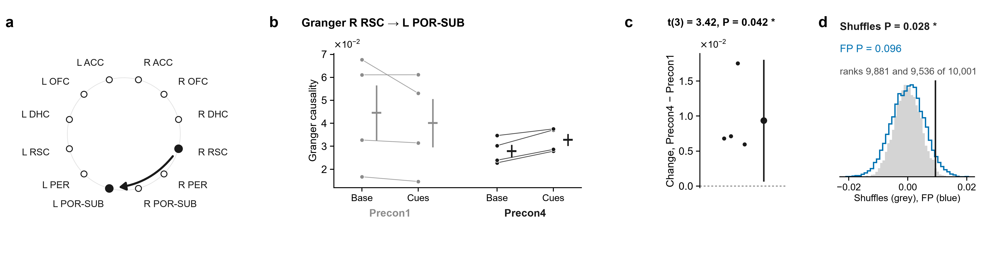
1.5 · R RSC – L POR-SUB · Which leads
R RSC predicting L POR-SUB (Granger R RSC → L POR-SUB): cue − baseline was higher on Precon4 than on Precon1.
R DHC and L RSC gamma bursts rising together (amplitude correlation): cue − baseline was higher on Precon4 than on Precon1.
t-test P = 0.042 (4 rats). Shuffles P = 0.028. FP P = 0.096. Only the shuffle agrees: a middling lead.
t-test P = 0.044 (7 rats). Shuffles P = 0.014. FP P = 0.047. Both second opinions agree: a stronger lead.
Notes:
Baseline (20 s) → both cues, gamma, R RSC – L POR-SUB: direction. a, the pair on the ring of regions (the arrow, the direction measured). Then, for each measure: its value for each rat at Baseline (20 s) and Cue 1 + Cue 2 (20 s) on Precon1 (grey) and Precon4 (black), each rat's two windows joined, the mean ± s.e.m. beside them; each rat's change between the days, (Precon4 Cue 1 + Cue 2 (20 s) − Baseline (20 s)) − (Precon1 Cue 1 + Cue 2 (20 s) − Baseline (20 s)), with the mean ± 95% confidence interval; and that mean against 10,000 shuffles in which each session's trials had their two windows swapped at random (grey) and against 10,000 sets of fake trials from the same rats' FP1 and FP2, where there were no cues, each session as many as it had real trials, in random order, losing the windows its real trials lost (blue). The pair was followed up because its own change in coherence had P < 0.05 (uncorrected; no pair survives correction on its own), and of the measures run on it these are the ones whose t-test had P < 0.05: they are leads, chosen by that test. Granger R RSC → L POR-SUB: t(3) = 3.42, P = 0.042 (one-sample t-test of each rat's change, uncorrected); within-session shuffles P = 0.028, rank 9,881 of 10,001; FP intervals P = 0.096, rank 9,536 of 10,001.

Slide 59
1.5 · R RSC – L POR-SUB · Which leads
R RSC predicting L POR-SUB (Granger R RSC → L POR-SUB): cue − baseline was higher on Precon4 than on Precon1.
R PER and L DHC gamma bursts rising together (amplitude correlation): cue − baseline was lower on Precon4 than on Precon1.
t-test P = 0.042 (4 rats). Shuffles P = 0.028. FP P = 0.096. Only the shuffle agrees: a middling lead.
Notes:
t(3) = 3.42, P = 0.042; mean change 0.009354. Shuffles: rank 9881 of 10001, P = 0.028. FP: rank 9536 of 10001, P = 0.096.

Slide 60
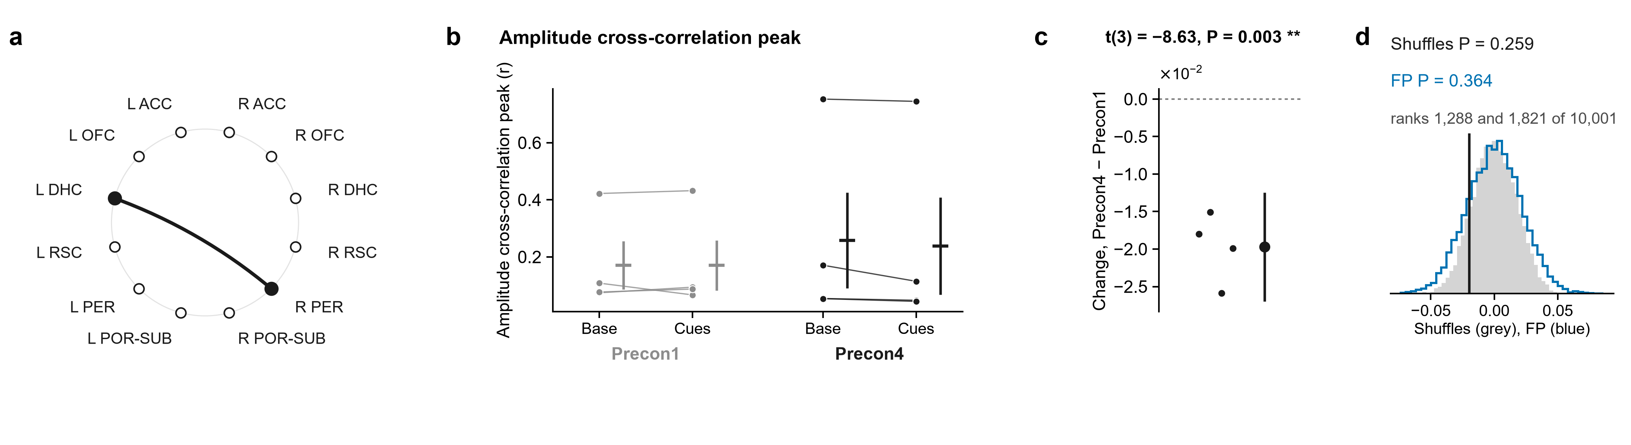
1.6 · R PER – L DHC · Bursts rise together
R PER and L DHC gamma bursts rising together (amplitude correlation): cue − baseline was lower on Precon4 than on Precon1.
R RSC predicting L POR-SUB (Granger R RSC → L POR-SUB): cue − baseline was higher on Precon4 than on Precon1.
t-test P = 0.003 (4 rats). Shuffles P = 0.259. FP P = 0.364. Neither second opinion agrees: a weaker lead.
t-test P = 0.042 (4 rats). Shuffles P = 0.028. FP P = 0.096. Only the shuffle agrees: a middling lead.
Notes:
Baseline (20 s) → both cues, gamma, R PER – L DHC: amplitudes together. a, the pair on the ring of regions. Then, for each measure: its value for each rat at Baseline (20 s) and Cue 1 + Cue 2 (20 s) on Precon1 (grey) and Precon4 (black), each rat's two windows joined, the mean ± s.e.m. beside them; each rat's change between the days, (Precon4 Cue 1 + Cue 2 (20 s) − Baseline (20 s)) − (Precon1 Cue 1 + Cue 2 (20 s) − Baseline (20 s)), with the mean ± 95% confidence interval; and that mean against 10,000 shuffles in which each session's trials had their two windows swapped at random (grey) and against 10,000 sets of fake trials from the same rats' FP1 and FP2, where there were no cues, each session as many as it had real trials, in random order, losing the windows its real trials lost (blue). The pair was followed up because its own change in coherence had P < 0.05 (uncorrected; no pair survives correction on its own), and of the measures run on it these are the ones whose t-test had P < 0.05: they are leads, chosen by that test. Amplitude cross-correlation peak: t(3) = −8.63, P = 0.003 (one-sample t-test of each rat's change, uncorrected); within-session shuffles P = 0.259, rank 1,288 of 10,001; FP intervals P = 0.364, rank 1,821 of 10,001.

Slide 61
1.6 · R PER – L DHC · Bursts rise together
R PER and L DHC gamma bursts rising together (amplitude correlation): cue − baseline was lower on Precon4 than on Precon1.
Theta pacing gamma within R PER (PAC): cue − baseline was higher on Precon4 than on Precon1.
t-test P = 0.003 (4 rats). Shuffles P = 0.259. FP P = 0.364. Neither second opinion agrees: a weaker lead.
Notes:
t(3) = -8.63, P = 0.003; mean change -0.01971. Shuffles: rank 1288 of 10001, P = 0.259. FP: rank 1821 of 10001, P = 0.364.

Slide 62
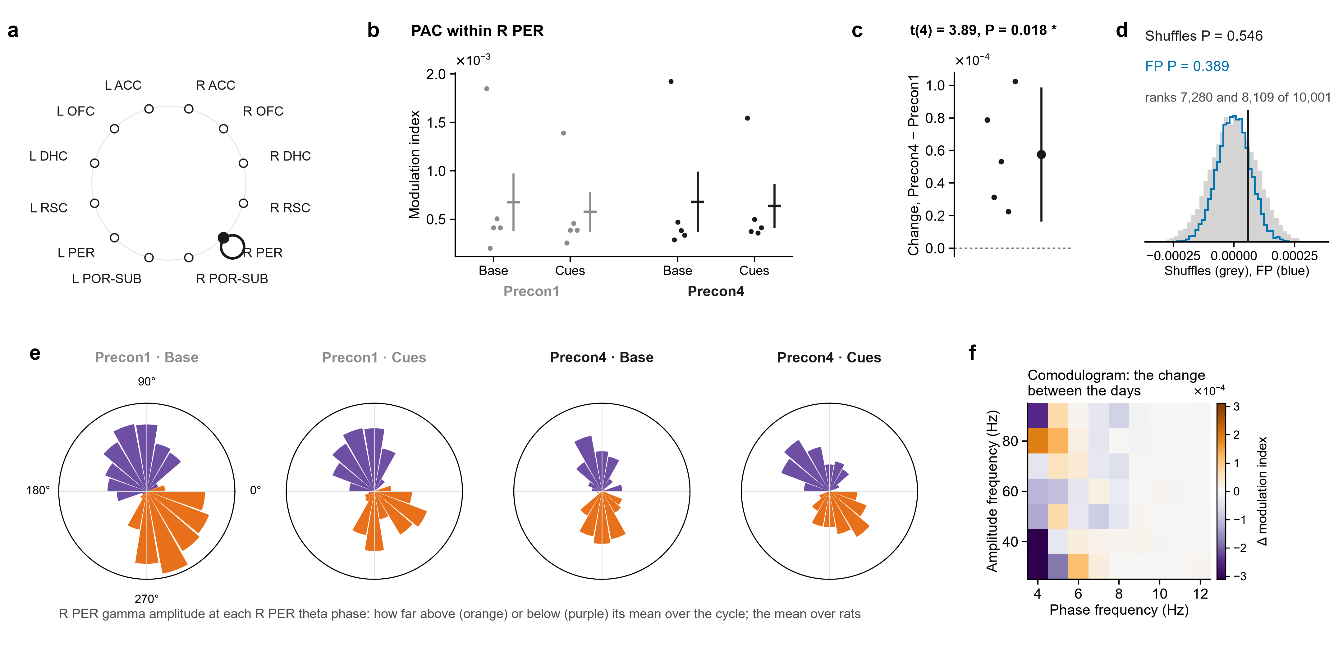
1.7 · R PER – L DHC · Theta paces gamma
Theta pacing gamma within R PER (PAC): cue − baseline was higher on Precon4 than on Precon1.
R PER and L DHC gamma bursts rising together (amplitude correlation): cue − baseline was lower on Precon4 than on Precon1.
t-test P = 0.018 (5 rats). Shuffles P = 0.546. FP P = 0.389. Neither second opinion agrees: a weaker lead.
t-test P = 0.003 (4 rats). Shuffles P = 0.259. FP P = 0.364. Neither second opinion agrees: a weaker lead.
Notes:
Baseline (20 s) → both cues, gamma, R PER – L DHC: phase–amplitude coupling. a, the pair on the ring of regions. Then, for each measure: its value for each rat at Baseline (20 s) and Cue 1 + Cue 2 (20 s) on Precon1 (grey) and Precon4 (black), each rat's values as dots (PAC is never drawn as lines), the mean ± s.e.m. beside them; each rat's change between the days, (Precon4 Cue 1 + Cue 2 (20 s) − Baseline (20 s)) − (Precon1 Cue 1 + Cue 2 (20 s) − Baseline (20 s)), with the mean ± 95% confidence interval; and that mean against 10,000 shuffles in which each session's trials had their two windows swapped at random (grey) and against 10,000 sets of fake trials from the same rats' FP1 and FP2, where there were no cues, each session as many as it had real trials, in random order, losing the windows its real trials lost (blue). The pair was followed up because its own change in coherence had P < 0.05 (uncorrected; no pair survives correction on its own), and of the measures run on it these are the ones whose t-test had P < 0.05: they are leads, chosen by that test. PAC within R PER: t(4) = 3.89, P = 0.018 (one-sample t-test of each rat's change, uncorrected); within-session shuffles P = 0.546, rank 7,280 of 10,001; FP intervals P = 0.389, rank 8,109 of 10,001.

Slide 63
1.7 · R PER – L DHC · Theta paces gamma
Theta pacing gamma within R PER (PAC): cue − baseline was higher on Precon4 than on Precon1.
Its roses: R PER gamma around the R PER theta cycle, averaged over rats, Precon1 then Precon4. Where in the cycle, not how much: c is the result.
t-test P = 0.018 (5 rats). Shuffles P = 0.546. FP P = 0.389. Neither second opinion agrees: a weaker lead.
Notes:
t(4) = 3.89, P = 0.018; mean change 5.763e-05. Shuffles: rank 7280 of 10001, P = 0.546. FP: rank 8109 of 10001, P = 0.389.

Slide 64
1.7 · R PER – L DHC · Theta paces gamma
Its roses: R PER gamma around the R PER theta cycle, averaged over rats, Precon1 then Precon4. Where in the cycle, not how much: c is the result.
R ACC and R OFC gamma bursts rising together (amplitude correlation): cue − baseline was higher on Precon4 than on Precon1.
Theta pacing gamma within R PER (PAC): cue − baseline was higher on Precon4 than on Precon1.
t-test P = 0.018 (5 rats). Shuffles P = 0.546. FP P = 0.389. Neither second opinion agrees: a weaker lead.

Slide 65
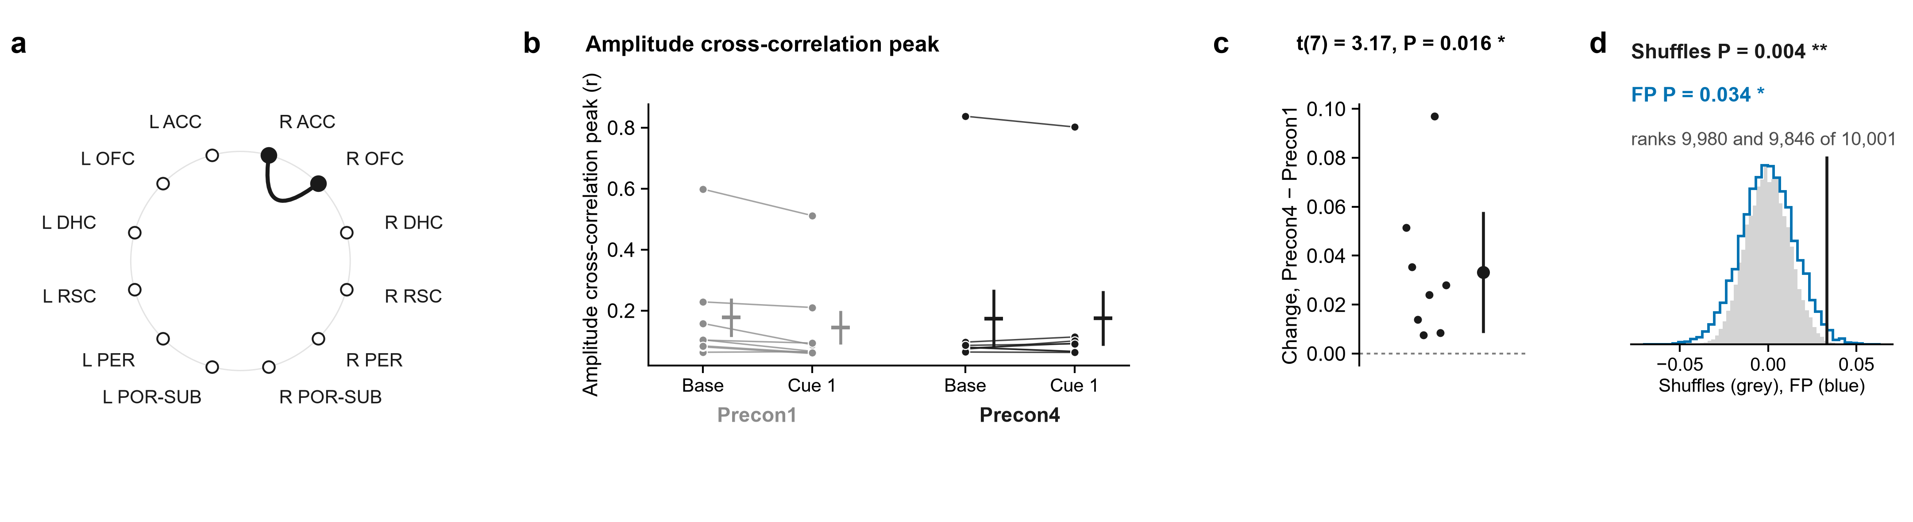
2.1 · R ACC – R OFC · Bursts rise together
R ACC and R OFC gamma bursts rising together (amplitude correlation): cue − baseline was higher on Precon4 than on Precon1.
Its roses: R PER gamma around the R PER theta cycle, averaged over rats, Precon1 then Precon4. Where in the cycle, not how much: c is the result.
t-test P = 0.016 (8 rats). Shuffles P = 0.004. FP P = 0.034. Both second opinions agree: a stronger lead.
Notes:
Baseline (10 s) → cue 1, gamma, R ACC – R OFC: amplitudes together. a, the pair on the ring of regions. Then, for each measure: its value for each rat at Baseline (10 s) and Cue 1 on Precon1 (grey) and Precon4 (black), each rat's two windows joined, the mean ± s.e.m. beside them; each rat's change between the days, (Precon4 Cue 1 − Baseline (10 s)) − (Precon1 Cue 1 − Baseline (10 s)), with the mean ± 95% confidence interval; and that mean against 10,000 shuffles in which each session's trials had their two windows swapped at random (grey) and against 10,000 sets of fake trials from the same rats' FP1 and FP2, where there were no cues, each session as many as it had real trials, in random order, losing the windows its real trials lost (blue). The pair was followed up because its own change in coherence had P < 0.05 (uncorrected; no pair survives correction on its own), and of the measures run on it these are the ones whose t-test had P < 0.05: they are leads, chosen by that test. Amplitude cross-correlation peak: t(7) = 3.17, P = 0.016 (one-sample t-test of each rat's change, uncorrected); within-session shuffles P = 0.004, rank 9,980 of 10,001; FP intervals P = 0.034, rank 9,846 of 10,001.

Slide 66
2.1 · R ACC – R OFC · Bursts rise together
R ACC and R OFC gamma bursts rising together (amplitude correlation): cue − baseline was higher on Precon4 than on Precon1.
Coupling with a real delay, R ACC with R RSC (imaginary coherence): cue − baseline was higher on Precon4 than on Precon1.
t-test P = 0.016 (8 rats). Shuffles P = 0.004. FP P = 0.034. Both second opinions agree: a stronger lead.
Notes:
t(7) = 3.17, P = 0.016; mean change 0.03322. Shuffles: rank 9980 of 10001, P = 0.004. FP: rank 9846 of 10001, P = 0.034.

Slide 67
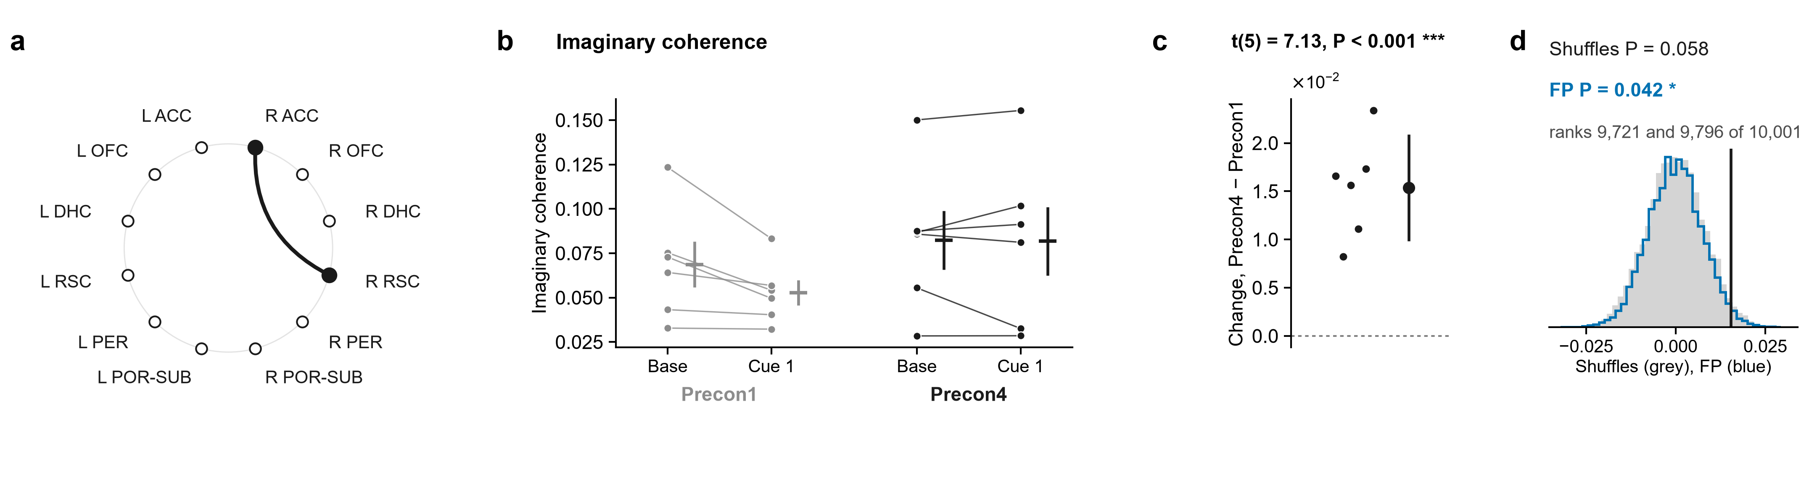
2.2 · R ACC – R RSC · Not just a shared signal
Coupling with a real delay, R ACC with R RSC (imaginary coherence): cue − baseline was higher on Precon4 than on Precon1.
R ACC and R OFC gamma bursts rising together (amplitude correlation): cue − baseline was higher on Precon4 than on Precon1.
t-test P < 0.001 (6 rats). Shuffles P = 0.058. FP P = 0.042. Only FP agrees: a middling lead.
t-test P = 0.016 (8 rats). Shuffles P = 0.004. FP P = 0.034. Both second opinions agree: a stronger lead.
Notes:
Baseline (10 s) → cue 1, gamma, R ACC – R RSC: not volume conduction. a, the pair on the ring of regions. Then, for each measure: its value for each rat at Baseline (10 s) and Cue 1 on Precon1 (grey) and Precon4 (black), each rat's two windows joined, the mean ± s.e.m. beside them; each rat's change between the days, (Precon4 Cue 1 − Baseline (10 s)) − (Precon1 Cue 1 − Baseline (10 s)), with the mean ± 95% confidence interval; and that mean against 10,000 shuffles in which each session's trials had their two windows swapped at random (grey) and against 10,000 sets of fake trials from the same rats' FP1 and FP2, where there were no cues, each session as many as it had real trials, in random order, losing the windows its real trials lost (blue). The pair was followed up because its own change in coherence had P < 0.05 (uncorrected; no pair survives correction on its own), and of the measures run on it these are the ones whose t-test had P < 0.05: they are leads, chosen by that test. Imaginary coherence: t(5) = 7.13, P < 0.001 (one-sample t-test of each rat's change, uncorrected); within-session shuffles P = 0.058, rank 9,721 of 10,001; FP intervals P = 0.042, rank 9,796 of 10,001.

Slide 68
2.2 · R ACC – R RSC · Not just a shared signal
Coupling with a real delay, R ACC with R RSC (imaginary coherence): cue − baseline was higher on Precon4 than on Precon1.
R ACC and L RSC gamma bursts rising together (amplitude correlation): cue − baseline was higher on Precon4 than on Precon1.
t-test P < 0.001 (6 rats). Shuffles P = 0.058. FP P = 0.042. Only FP agrees: a middling lead.
Notes:
t(5) = 7.13, P < 0.001; mean change 0.01537. Shuffles: rank 9721 of 10001, P = 0.058. FP: rank 9796 of 10001, P = 0.042.

Slide 69
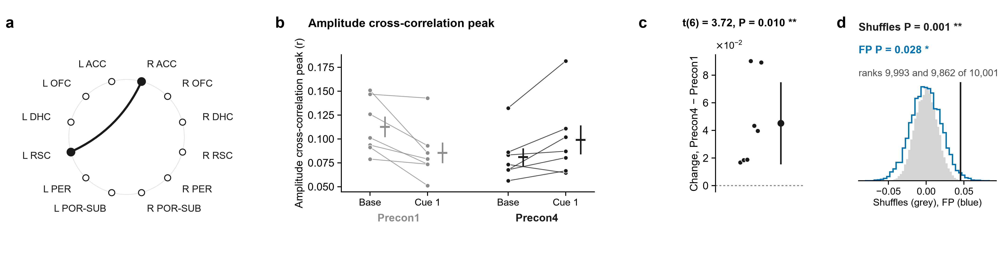
2.3 · R ACC – L RSC · Bursts rise together
R ACC and L RSC gamma bursts rising together (amplitude correlation): cue − baseline was higher on Precon4 than on Precon1.
Coupling with a real delay, R ACC with R RSC (imaginary coherence): cue − baseline was higher on Precon4 than on Precon1.
t-test P = 0.010 (7 rats). Shuffles P = 0.001. FP P = 0.028. Both second opinions agree: a stronger lead.
t-test P < 0.001 (6 rats). Shuffles P = 0.058. FP P = 0.042. Only FP agrees: a middling lead.
Notes:
Baseline (10 s) → cue 1, gamma, R ACC – L RSC: amplitudes together. a, the pair on the ring of regions. Then, for each measure: its value for each rat at Baseline (10 s) and Cue 1 on Precon1 (grey) and Precon4 (black), each rat's two windows joined, the mean ± s.e.m. beside them; each rat's change between the days, (Precon4 Cue 1 − Baseline (10 s)) − (Precon1 Cue 1 − Baseline (10 s)), with the mean ± 95% confidence interval; and that mean against 10,000 shuffles in which each session's trials had their two windows swapped at random (grey) and against 10,000 sets of fake trials from the same rats' FP1 and FP2, where there were no cues, each session as many as it had real trials, in random order, losing the windows its real trials lost (blue). The pair was followed up because its own change in coherence had P < 0.05 (uncorrected; no pair survives correction on its own), and of the measures run on it these are the ones whose t-test had P < 0.05: they are leads, chosen by that test. Amplitude cross-correlation peak: t(6) = 3.72, P = 0.010 (one-sample t-test of each rat's change, uncorrected); within-session shuffles P = 0.001, rank 9,993 of 10,001; FP intervals P = 0.028, rank 9,862 of 10,001.

Slide 70
2.3 · R ACC – L RSC · Bursts rise together
R ACC and L RSC gamma bursts rising together (amplitude correlation): cue − baseline was higher on Precon4 than on Precon1.
Steady-delay coupling, R ACC with L OFC (PLI): cue − baseline was higher on Precon4 than on Precon1.
t-test P = 0.010 (7 rats). Shuffles P = 0.001. FP P = 0.028. Both second opinions agree: a stronger lead.
Notes:
t(6) = 3.72, P = 0.010; mean change 0.04523. Shuffles: rank 9993 of 10001, P = 0.001. FP: rank 9862 of 10001, P = 0.028.

Slide 71
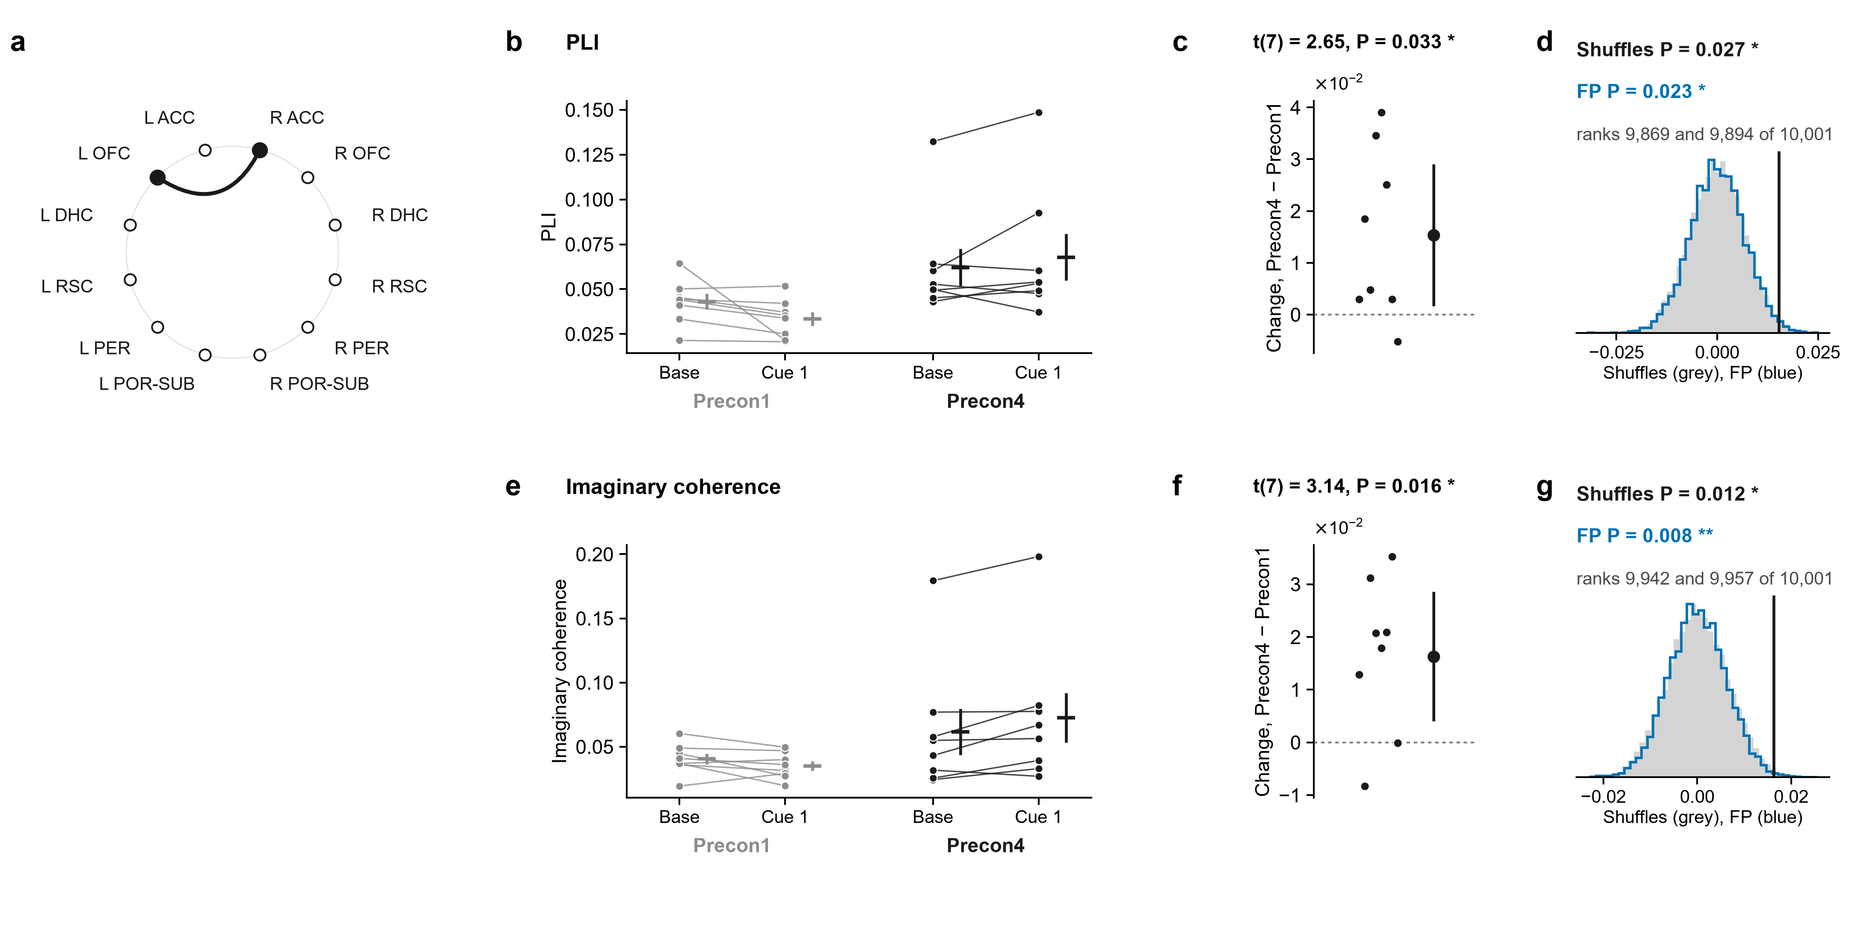
2.4 · R ACC – L OFC · Not just a shared signal
Steady-delay coupling, R ACC with L OFC (PLI): cue − baseline was higher on Precon4 than on Precon1.
R ACC and L RSC gamma bursts rising together (amplitude correlation): cue − baseline was higher on Precon4 than on Precon1.
t-test P = 0.033 (8 rats). Shuffles P = 0.027. FP P = 0.023. Both second opinions agree: a stronger lead.
t-test P = 0.010 (7 rats). Shuffles P = 0.001. FP P = 0.028. Both second opinions agree: a stronger lead.
Notes:
Baseline (10 s) → cue 1, gamma, R ACC – L OFC: not volume conduction. a, the pair on the ring of regions. Then, for each measure: its value for each rat at Baseline (10 s) and Cue 1 on Precon1 (grey) and Precon4 (black), each rat's two windows joined, the mean ± s.e.m. beside them; each rat's change between the days, (Precon4 Cue 1 − Baseline (10 s)) − (Precon1 Cue 1 − Baseline (10 s)), with the mean ± 95% confidence interval; and that mean against 10,000 shuffles in which each session's trials had their two windows swapped at random (grey) and against 10,000 sets of fake trials from the same rats' FP1 and FP2, where there were no cues, each session as many as it had real trials, in random order, losing the windows its real trials lost (blue). The pair was followed up because its own change in coherence had P < 0.05 (uncorrected; no pair survives correction on its own), and of the measures run on it these are the ones whose t-test had P < 0.05: they are leads, chosen by that test. PLI: t(7) = 2.65, P = 0.033 (one-sample t-test of each rat's change, uncorrected); within-session shuffles P = 0.027, rank 9,869 of 10,001; FP intervals P = 0.023, rank 9,894 of 10,001; Imaginary coherence: t(7) = 3.14, P = 0.016 (one-sample t-test of each rat's change, uncorrected); within-session shuffles P = 0.012, rank 9,942 of 10,001; FP intervals P = 0.008, rank 9,957 of 10,001.

Slide 72
2.4 · R ACC – L OFC · Not just a shared signal
Steady-delay coupling, R ACC with L OFC (PLI): cue − baseline was higher on Precon4 than on Precon1.
t-test P = 0.033 (8 rats). Shuffles P = 0.027. FP P = 0.023. Both second opinions agree: a stronger lead.
Coupling with a real delay, R ACC with L OFC (imaginary coherence): cue − baseline was higher on Precon4 than on Precon1.
Notes:
t(7) = 2.65, P = 0.033; mean change 0.01533. Shuffles: rank 9869 of 10001, P = 0.027. FP: rank 9894 of 10001, P = 0.023.

Slide 73
2.4 · R ACC – L OFC · Not just a shared signal
Steady-delay coupling, R ACC with L OFC (PLI): cue − baseline was higher on Precon4 than on Precon1.
t-test P = 0.033 (8 rats). Shuffles P = 0.027. FP P = 0.023. Both second opinions agree: a stronger lead.
Coupling with a real delay, R ACC with L OFC (imaginary coherence): cue − baseline was higher on Precon4 than on Precon1.
t-test P = 0.016 (8 rats). Shuffles P = 0.012. FP P = 0.008. Both second opinions agree: a stronger lead.

Slide 74
2.4 · R ACC – L OFC · Not just a shared signal
Steady-delay coupling, R ACC with L OFC (PLI): cue − baseline was higher on Precon4 than on Precon1.
Theta in R ACC pacing gamma in L OFC (PAC): cue − baseline was higher on Precon4 than on Precon1.
t-test P = 0.033 (8 rats). Shuffles P = 0.027. FP P = 0.023. Both second opinions agree: a stronger lead.
Coupling with a real delay, R ACC with L OFC (imaginary coherence): cue − baseline was higher on Precon4 than on Precon1.
t-test P = 0.016 (8 rats). Shuffles P = 0.012. FP P = 0.008. Both second opinions agree: a stronger lead.
Notes:
t(7) = 3.14, P = 0.016; mean change 0.0163. Shuffles: rank 9942 of 10001, P = 0.012. FP: rank 9957 of 10001, P = 0.008.

Slide 75
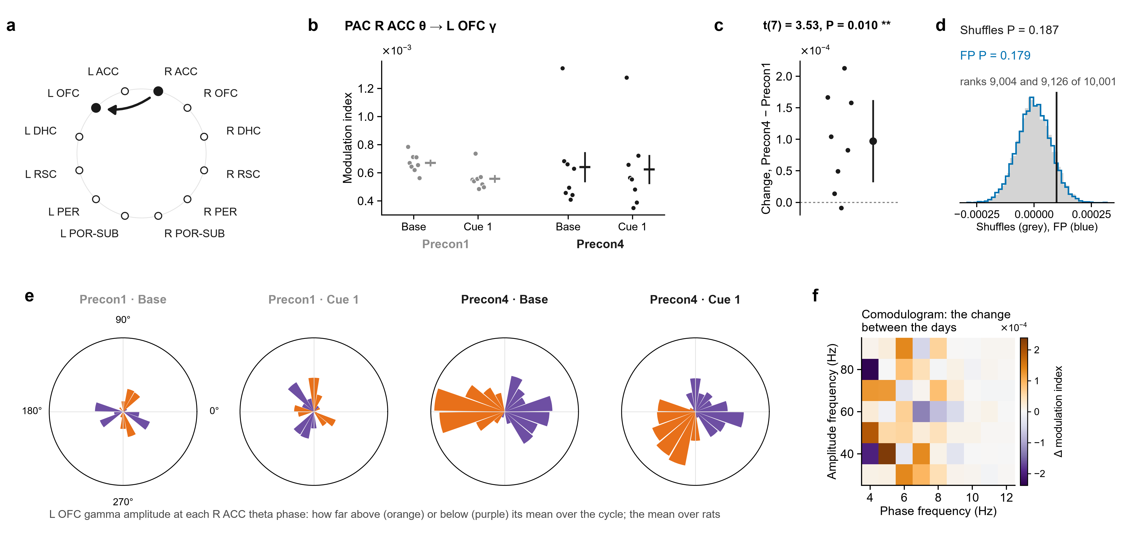
2.5 · R ACC – L OFC · Theta paces gamma
Theta in R ACC pacing gamma in L OFC (PAC): cue − baseline was higher on Precon4 than on Precon1.
Steady-delay coupling, R ACC with L OFC (PLI): cue − baseline was higher on Precon4 than on Precon1.
t-test P = 0.010 (8 rats). Shuffles P = 0.187. FP P = 0.179. Neither second opinion agrees: a weaker lead.
t-test P = 0.033 (8 rats). Shuffles P = 0.027. FP P = 0.023. Both second opinions agree: a stronger lead.
Coupling with a real delay, R ACC with L OFC (imaginary coherence): cue − baseline was higher on Precon4 than on Precon1.
t-test P = 0.016 (8 rats). Shuffles P = 0.012. FP P = 0.008. Both second opinions agree: a stronger lead.
Notes:
Baseline (10 s) → cue 1, gamma, R ACC – L OFC: phase–amplitude coupling. a, the pair on the ring of regions (the arrow, the direction measured). Then, for each measure: its value for each rat at Baseline (10 s) and Cue 1 on Precon1 (grey) and Precon4 (black), each rat's values as dots (PAC is never drawn as lines), the mean ± s.e.m. beside them; each rat's change between the days, (Precon4 Cue 1 − Baseline (10 s)) − (Precon1 Cue 1 − Baseline (10 s)), with the mean ± 95% confidence interval; and that mean against 10,000 shuffles in which each session's trials had their two windows swapped at random (grey) and against 10,000 sets of fake trials from the same rats' FP1 and FP2, where there were no cues, each session as many as it had real trials, in random order, losing the windows its real trials lost (blue). The pair was followed up because its own change in coherence had P < 0.05 (uncorrected; no pair survives correction on its own), and of the measures run on it these are the ones whose t-test had P < 0.05: they are leads, chosen by that test. PAC R ACC θ → L OFC γ: t(7) = 3.53, P = 0.010 (one-sample t-test of each rat's change, uncorrected); within-session shuffles P = 0.187, rank 9,004 of 10,001; FP intervals P = 0.179, rank 9,126 of 10,001.

Slide 76
2.5 · R ACC – L OFC · Theta paces gamma
Theta in R ACC pacing gamma in L OFC (PAC): cue − baseline was higher on Precon4 than on Precon1.
Its roses: L OFC gamma around the R ACC theta cycle, averaged over rats, Precon1 then Precon4. Where in the cycle, not how much: c is the result.
t-test P = 0.010 (8 rats). Shuffles P = 0.187. FP P = 0.179. Neither second opinion agrees: a weaker lead.
Notes:
t(7) = 3.53, P = 0.010; mean change 9.734e-05. Shuffles: rank 9004 of 10001, P = 0.187. FP: rank 9126 of 10001, P = 0.179.

Slide 77
2.5 · R ACC – L OFC · Theta paces gamma
Its roses: L OFC gamma around the R ACC theta cycle, averaged over rats, Precon1 then Precon4. Where in the cycle, not how much: c is the result.
Coupling with a real delay, R ACC with L ACC (imaginary coherence): cue − baseline was higher on Precon4 than on Precon1.
Theta in R ACC pacing gamma in L OFC (PAC): cue − baseline was higher on Precon4 than on Precon1.
t-test P = 0.010 (8 rats). Shuffles P = 0.187. FP P = 0.179. Neither second opinion agrees: a weaker lead.

Slide 78
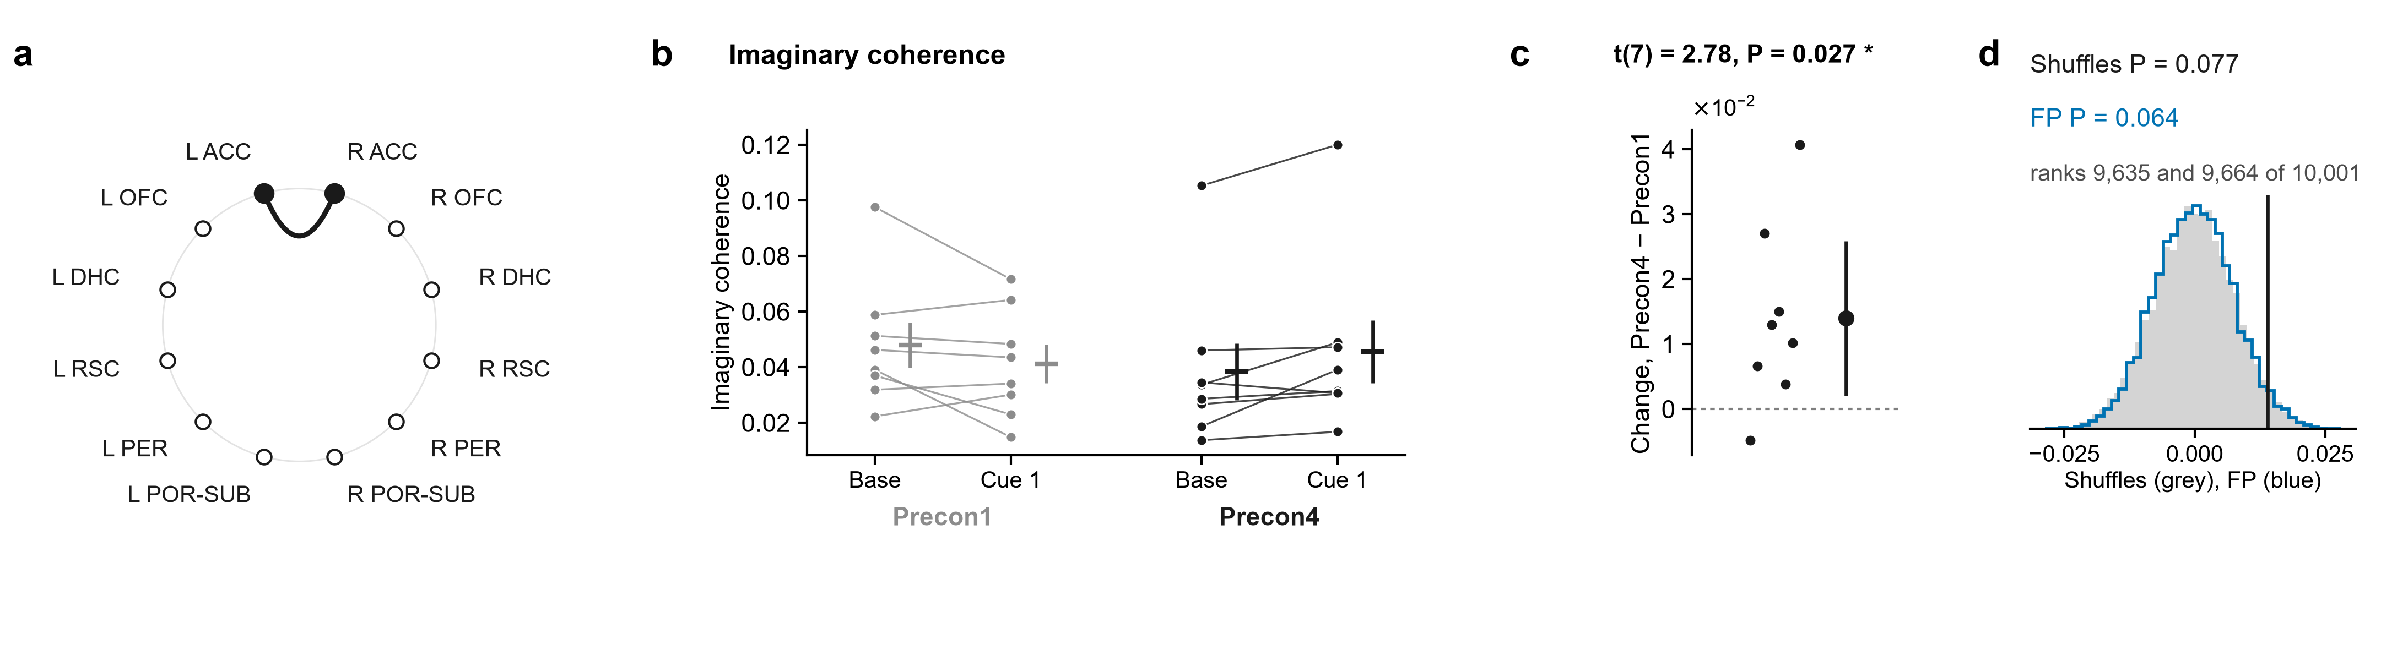
2.6 · R ACC – L ACC · Not just a shared signal
Coupling with a real delay, R ACC with L ACC (imaginary coherence): cue − baseline was higher on Precon4 than on Precon1.
Its roses: L OFC gamma around the R ACC theta cycle, averaged over rats, Precon1 then Precon4. Where in the cycle, not how much: c is the result.
t-test P = 0.027 (8 rats). Shuffles P = 0.077. FP P = 0.064. Neither second opinion agrees: a weaker lead.
Notes:
Baseline (10 s) → cue 1, gamma, R ACC – L ACC: not volume conduction. a, the pair on the ring of regions. Then, for each measure: its value for each rat at Baseline (10 s) and Cue 1 on Precon1 (grey) and Precon4 (black), each rat's two windows joined, the mean ± s.e.m. beside them; each rat's change between the days, (Precon4 Cue 1 − Baseline (10 s)) − (Precon1 Cue 1 − Baseline (10 s)), with the mean ± 95% confidence interval; and that mean against 10,000 shuffles in which each session's trials had their two windows swapped at random (grey) and against 10,000 sets of fake trials from the same rats' FP1 and FP2, where there were no cues, each session as many as it had real trials, in random order, losing the windows its real trials lost (blue). The pair was followed up because its own change in coherence had P < 0.05 (uncorrected; no pair survives correction on its own), and of the measures run on it these are the ones whose t-test had P < 0.05: they are leads, chosen by that test. Imaginary coherence: t(7) = 2.78, P = 0.027 (one-sample t-test of each rat's change, uncorrected); within-session shuffles P = 0.077, rank 9,635 of 10,001; FP intervals P = 0.064, rank 9,664 of 10,001.

Slide 79
2.6 · R ACC – L ACC · Not just a shared signal
Coupling with a real delay, R ACC with L ACC (imaginary coherence): cue − baseline was higher on Precon4 than on Precon1.
R ACC and L ACC gamma bursts rising together (amplitude correlation): cue − baseline was higher on Precon4 than on Precon1.
t-test P = 0.027 (8 rats). Shuffles P = 0.077. FP P = 0.064. Neither second opinion agrees: a weaker lead.
Notes:
t(7) = 2.78, P = 0.027; mean change 0.01397. Shuffles: rank 9635 of 10001, P = 0.077. FP: rank 9664 of 10001, P = 0.064.

Slide 80
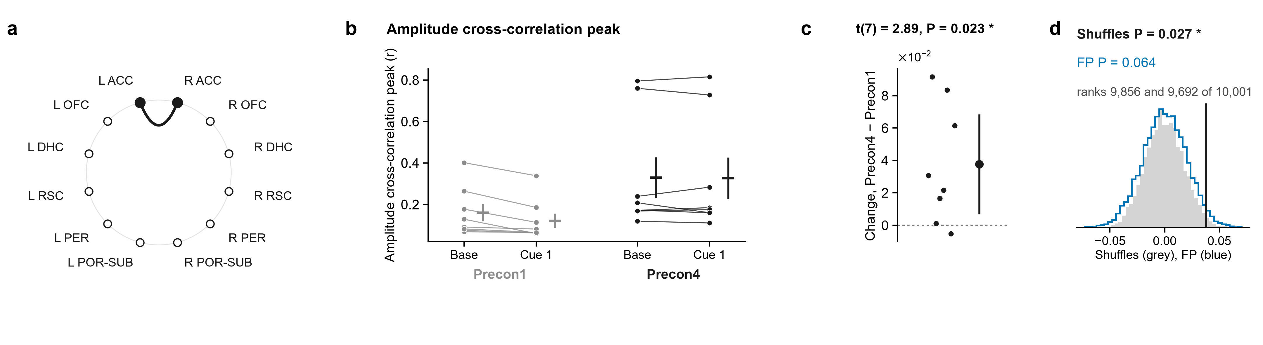
2.7 · R ACC – L ACC · Bursts rise together
R ACC and L ACC gamma bursts rising together (amplitude correlation): cue − baseline was higher on Precon4 than on Precon1.
Coupling with a real delay, R ACC with L ACC (imaginary coherence): cue − baseline was higher on Precon4 than on Precon1.
t-test P = 0.023 (8 rats). Shuffles P = 0.027. FP P = 0.064. Only the shuffle agrees: a middling lead.
t-test P = 0.027 (8 rats). Shuffles P = 0.077. FP P = 0.064. Neither second opinion agrees: a weaker lead.
Notes:
Baseline (10 s) → cue 1, gamma, R ACC – L ACC: amplitudes together. a, the pair on the ring of regions. Then, for each measure: its value for each rat at Baseline (10 s) and Cue 1 on Precon1 (grey) and Precon4 (black), each rat's two windows joined, the mean ± s.e.m. beside them; each rat's change between the days, (Precon4 Cue 1 − Baseline (10 s)) − (Precon1 Cue 1 − Baseline (10 s)), with the mean ± 95% confidence interval; and that mean against 10,000 shuffles in which each session's trials had their two windows swapped at random (grey) and against 10,000 sets of fake trials from the same rats' FP1 and FP2, where there were no cues, each session as many as it had real trials, in random order, losing the windows its real trials lost (blue). The pair was followed up because its own change in coherence had P < 0.05 (uncorrected; no pair survives correction on its own), and of the measures run on it these are the ones whose t-test had P < 0.05: they are leads, chosen by that test. Amplitude cross-correlation peak: t(7) = 2.89, P = 0.023 (one-sample t-test of each rat's change, uncorrected); within-session shuffles P = 0.027, rank 9,856 of 10,001; FP intervals P = 0.064, rank 9,692 of 10,001.

Slide 81
2.7 · R ACC – L ACC · Bursts rise together
R ACC and L ACC gamma bursts rising together (amplitude correlation): cue − baseline was higher on Precon4 than on Precon1.
Theta in L RSC pacing gamma in R OFC (PAC): cue − baseline was higher on Precon4 than on Precon1.
t-test P = 0.023 (8 rats). Shuffles P = 0.027. FP P = 0.064. Only the shuffle agrees: a middling lead.
Notes:
t(7) = 2.89, P = 0.023; mean change 0.03769. Shuffles: rank 9856 of 10001, P = 0.027. FP: rank 9692 of 10001, P = 0.064.

Slide 82
2.8 · R OFC – L RSC · Theta paces gamma
Theta in L RSC pacing gamma in R OFC (PAC): cue − baseline was higher on Precon4 than on Precon1.
R ACC and L ACC gamma bursts rising together (amplitude correlation): cue − baseline was higher on Precon4 than on Precon1.
t-test P = 0.020 (7 rats). Shuffles P = 0.135. FP P = 0.298. Neither second opinion agrees: a weaker lead.
t-test P = 0.023 (8 rats). Shuffles P = 0.027. FP P = 0.064. Only the shuffle agrees: a middling lead.
Notes:
Baseline (10 s) → cue 1, gamma, R OFC – L RSC: phase–amplitude coupling. a, the pair on the ring of regions (the arrow, the direction measured). Then, for each measure: its value for each rat at Baseline (10 s) and Cue 1 on Precon1 (grey) and Precon4 (black), each rat's values as dots (PAC is never drawn as lines), the mean ± s.e.m. beside them; each rat's change between the days, (Precon4 Cue 1 − Baseline (10 s)) − (Precon1 Cue 1 − Baseline (10 s)), with the mean ± 95% confidence interval; and that mean against 10,000 shuffles in which each session's trials had their two windows swapped at random (grey) and against 10,000 sets of fake trials from the same rats' FP1 and FP2, where there were no cues, each session as many as it had real trials, in random order, losing the windows its real trials lost (blue). The pair was followed up because its own change in coherence had P < 0.05 (uncorrected; no pair survives correction on its own), and of the measures run on it these are the ones whose t-test had P < 0.05: they are leads, chosen by that test. PAC L RSC θ → R OFC γ: t(6) = 3.13, P = 0.020 (one-sample t-test of each rat's change, uncorrected); within-session shuffles P = 0.135, rank 9,285 of 10,001; FP intervals P = 0.298, rank 8,472 of 10,001.

Slide 83
2.8 · R OFC – L RSC · Theta paces gamma
Theta in L RSC pacing gamma in R OFC (PAC): cue − baseline was higher on Precon4 than on Precon1.
Its roses: R OFC gamma around the L RSC theta cycle, averaged over rats, Precon1 then Precon4. Where in the cycle, not how much: c is the result.
t-test P = 0.020 (7 rats). Shuffles P = 0.135. FP P = 0.298. Neither second opinion agrees: a weaker lead.
Notes:
t(6) = 3.13, P = 0.020; mean change 9.774e-05. Shuffles: rank 9285 of 10001, P = 0.135. FP: rank 8472 of 10001, P = 0.298.

Slide 84
2.8 · R OFC – L RSC · Theta paces gamma
Its roses: R OFC gamma around the L RSC theta cycle, averaged over rats, Precon1 then Precon4. Where in the cycle, not how much: c is the result.
Gamma-burst lag, R DHC with L RSC: how the cue shifted it differs between the days by 27 ms, toward R DHC leading on Precon4 compared with Precon1.
Theta in L RSC pacing gamma in R OFC (PAC): cue − baseline was higher on Precon4 than on Precon1.
t-test P = 0.020 (7 rats). Shuffles P = 0.135. FP P = 0.298. Neither second opinion agrees: a weaker lead.

Slide 85
2.9 · R DHC – L RSC · Which leads
Gamma-burst lag, R DHC with L RSC: how the cue shifted it differs between the days by 27 ms, toward R DHC leading on Precon4 compared with Precon1.
Its roses: R OFC gamma around the L RSC theta cycle, averaged over rats, Precon1 then Precon4. Where in the cycle, not how much: c is the result.
t-test P = 0.013 (7 rats). Shuffles P = 0.020. FP P = 0.014. Both second opinions agree: a stronger lead.
Notes:
Baseline (10 s) → cue 1, gamma, R DHC – L RSC: direction. a, the pair on the ring of regions. Then, for each measure: its value for each rat at Baseline (10 s) and Cue 1 on Precon1 (grey) and Precon4 (black), each rat's two windows joined, the mean ± s.e.m. beside them; each rat's change between the days, (Precon4 Cue 1 − Baseline (10 s)) − (Precon1 Cue 1 − Baseline (10 s)), with the mean ± 95% confidence interval; and that mean against 10,000 shuffles in which each session's trials had their two windows swapped at random (grey) and against 10,000 sets of fake trials from the same rats' FP1 and FP2, where there were no cues, each session as many as it had real trials, in random order, losing the windows its real trials lost (blue). The pair was followed up because its own change in coherence had P < 0.05 (uncorrected; no pair survives correction on its own), and of the measures run on it these are the ones whose t-test had P < 0.05: they are leads, chosen by that test. Amplitude lag: t(6) = −3.47, P = 0.013 (one-sample t-test of each rat's change, uncorrected); within-session shuffles P = 0.020, rank 98 of 10,001; FP intervals P = 0.014, rank 72 of 10,001.

Slide 86
2.9 · R DHC – L RSC · Which leads
Gamma-burst lag, R DHC with L RSC: how the cue shifted it differs between the days by 27 ms, toward R DHC leading on Precon4 compared with Precon1.
R DHC and L OFC gamma bursts rising together (amplitude correlation): cue − baseline was higher on Precon4 than on Precon1.
t-test P = 0.013 (7 rats). Shuffles P = 0.020. FP P = 0.014. Both second opinions agree: a stronger lead.
Notes:
t(6) = -3.47, P = 0.013; mean change -27.44. Shuffles: rank 98 of 10001, P = 0.020. FP: rank 72 of 10001, P = 0.014.

Slide 87
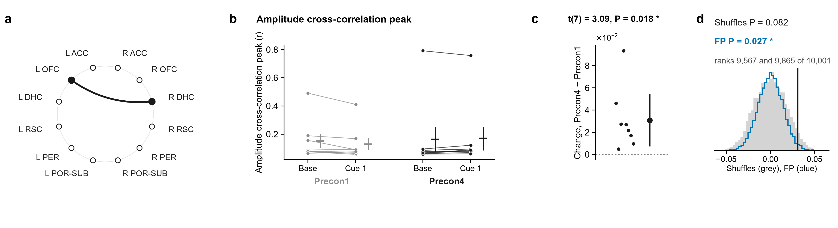
2.10 · R DHC – L OFC · Bursts rise together
R DHC and L OFC gamma bursts rising together (amplitude correlation): cue − baseline was higher on Precon4 than on Precon1.
Gamma-burst lag, R DHC with L RSC: how the cue shifted it differs between the days by 27 ms, toward R DHC leading on Precon4 compared with Precon1.
t-test P = 0.018 (8 rats). Shuffles P = 0.082. FP P = 0.027. Only FP agrees: a middling lead.
t-test P = 0.013 (7 rats). Shuffles P = 0.020. FP P = 0.014. Both second opinions agree: a stronger lead.
Notes:
Baseline (10 s) → cue 1, gamma, R DHC – L OFC: amplitudes together. a, the pair on the ring of regions. Then, for each measure: its value for each rat at Baseline (10 s) and Cue 1 on Precon1 (grey) and Precon4 (black), each rat's two windows joined, the mean ± s.e.m. beside them; each rat's change between the days, (Precon4 Cue 1 − Baseline (10 s)) − (Precon1 Cue 1 − Baseline (10 s)), with the mean ± 95% confidence interval; and that mean against 10,000 shuffles in which each session's trials had their two windows swapped at random (grey) and against 10,000 sets of fake trials from the same rats' FP1 and FP2, where there were no cues, each session as many as it had real trials, in random order, losing the windows its real trials lost (blue). The pair was followed up because its own change in coherence had P < 0.05 (uncorrected; no pair survives correction on its own), and of the measures run on it these are the ones whose t-test had P < 0.05: they are leads, chosen by that test. Amplitude cross-correlation peak: t(7) = 3.09, P = 0.018 (one-sample t-test of each rat's change, uncorrected); within-session shuffles P = 0.082, rank 9,567 of 10,001; FP intervals P = 0.027, rank 9,865 of 10,001.

Slide 88
2.10 · R DHC – L OFC · Bursts rise together
R DHC and L OFC gamma bursts rising together (amplitude correlation): cue − baseline was higher on Precon4 than on Precon1.
Theta in R DHC pacing gamma in L OFC (PAC): cue − baseline was higher on Precon4 than on Precon1.
t-test P = 0.018 (8 rats). Shuffles P = 0.082. FP P = 0.027. Only FP agrees: a middling lead.
Notes:
t(7) = 3.09, P = 0.018; mean change 0.03085. Shuffles: rank 9567 of 10001, P = 0.082. FP: rank 9865 of 10001, P = 0.027.

Slide 89
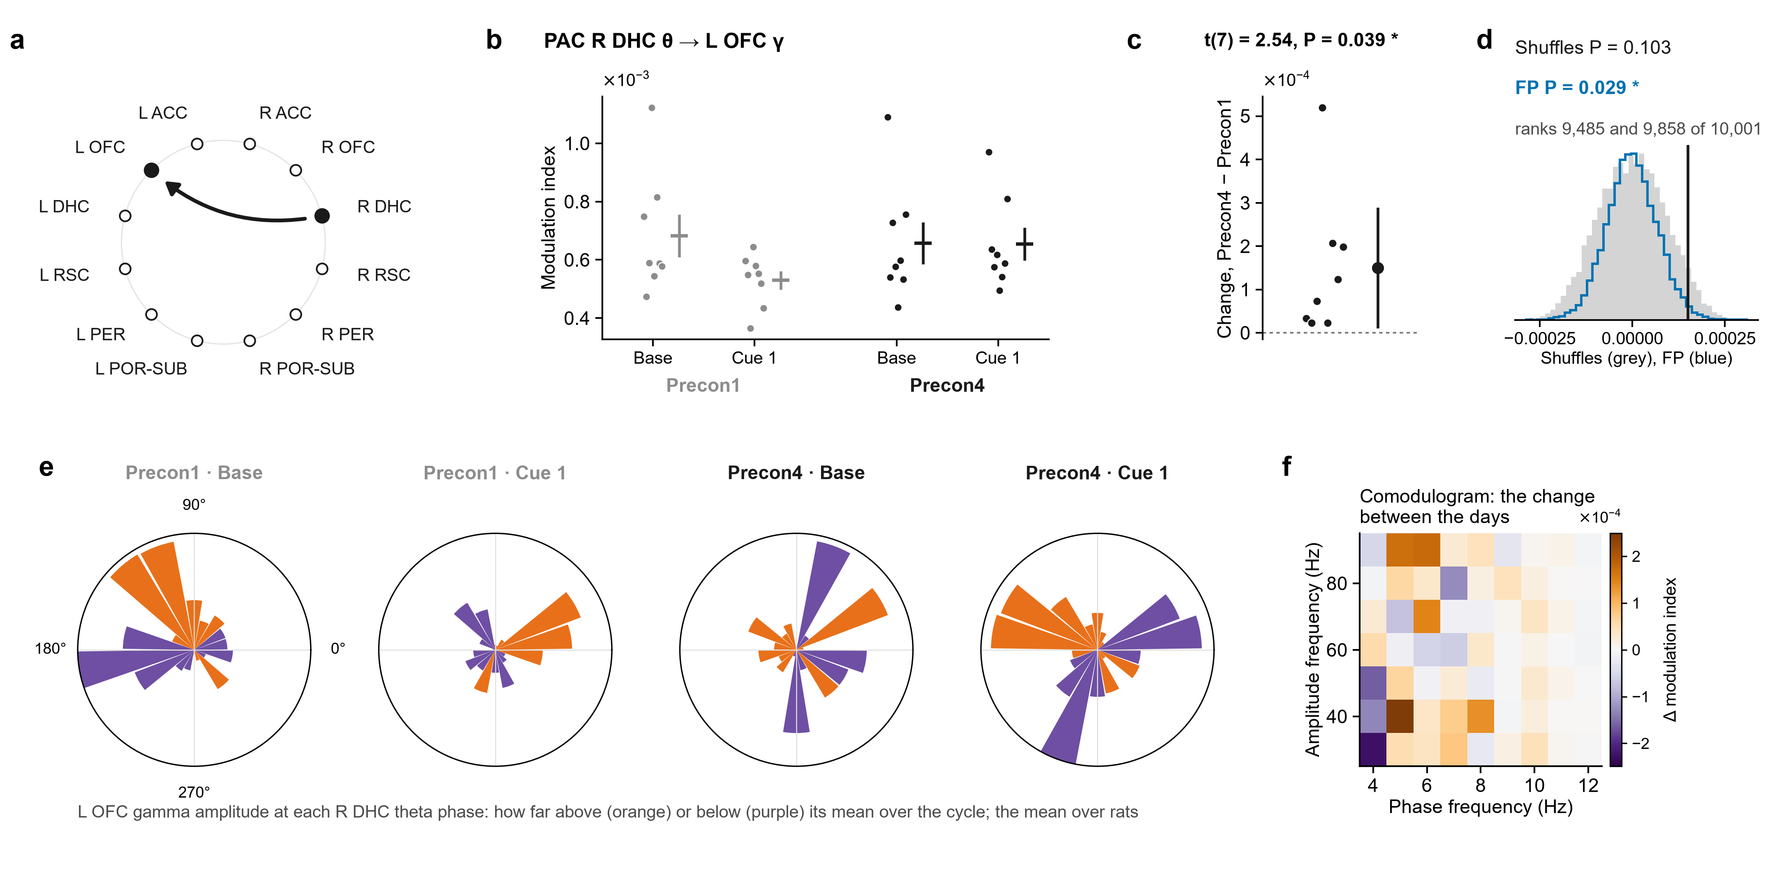
2.11 · R DHC – L OFC · Theta paces gamma
Theta in R DHC pacing gamma in L OFC (PAC): cue − baseline was higher on Precon4 than on Precon1.
R DHC and L OFC gamma bursts rising together (amplitude correlation): cue − baseline was higher on Precon4 than on Precon1.
t-test P = 0.039 (8 rats). Shuffles P = 0.103. FP P = 0.029. Only FP agrees: a middling lead.
t-test P = 0.018 (8 rats). Shuffles P = 0.082. FP P = 0.027. Only FP agrees: a middling lead.
Notes:
Baseline (10 s) → cue 1, gamma, R DHC – L OFC: phase–amplitude coupling. a, the pair on the ring of regions (the arrow, the direction measured). Then, for each measure: its value for each rat at Baseline (10 s) and Cue 1 on Precon1 (grey) and Precon4 (black), each rat's values as dots (PAC is never drawn as lines), the mean ± s.e.m. beside them; each rat's change between the days, (Precon4 Cue 1 − Baseline (10 s)) − (Precon1 Cue 1 − Baseline (10 s)), with the mean ± 95% confidence interval; and that mean against 10,000 shuffles in which each session's trials had their two windows swapped at random (grey) and against 10,000 sets of fake trials from the same rats' FP1 and FP2, where there were no cues, each session as many as it had real trials, in random order, losing the windows its real trials lost (blue). The pair was followed up because its own change in coherence had P < 0.05 (uncorrected; no pair survives correction on its own), and of the measures run on it these are the ones whose t-test had P < 0.05: they are leads, chosen by that test. PAC R DHC θ → L OFC γ: t(7) = 2.54, P = 0.039 (one-sample t-test of each rat's change, uncorrected); within-session shuffles P = 0.103, rank 9,485 of 10,001; FP intervals P = 0.029, rank 9,858 of 10,001.

Slide 90
2.11 · R DHC – L OFC · Theta paces gamma
Theta in R DHC pacing gamma in L OFC (PAC): cue − baseline was higher on Precon4 than on Precon1.
Its roses: L OFC gamma around the R DHC theta cycle, averaged over rats, Precon1 then Precon4. Where in the cycle, not how much: c is the result.
t-test P = 0.039 (8 rats). Shuffles P = 0.103. FP P = 0.029. Only FP agrees: a middling lead.
Notes:
t(7) = 2.54, P = 0.039; mean change 0.00015. Shuffles: rank 9485 of 10001, P = 0.103. FP: rank 9858 of 10001, P = 0.029.

Slide 91
2.11 · R DHC – L OFC · Theta paces gamma
Its roses: L OFC gamma around the R DHC theta cycle, averaged over rats, Precon1 then Precon4. Where in the cycle, not how much: c is the result.
L ACC predicting L RSC (Granger L ACC → L RSC): cue − baseline was higher on Precon4 than on Precon1.
Theta in R DHC pacing gamma in L OFC (PAC): cue − baseline was higher on Precon4 than on Precon1.
t-test P = 0.039 (8 rats). Shuffles P = 0.103. FP P = 0.029. Only FP agrees: a middling lead.

Slide 92
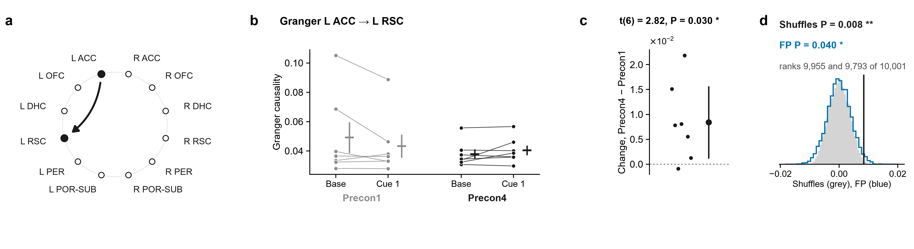
2.12 · L RSC – L ACC · Which leads
L ACC predicting L RSC (Granger L ACC → L RSC): cue − baseline was higher on Precon4 than on Precon1.
Its roses: L OFC gamma around the R DHC theta cycle, averaged over rats, Precon1 then Precon4. Where in the cycle, not how much: c is the result.
t-test P = 0.030 (7 rats). Shuffles P = 0.008. FP P = 0.040. Both second opinions agree: a stronger lead.
Notes:
Baseline (10 s) → cue 1, gamma, L RSC – L ACC: direction. a, the pair on the ring of regions (the arrow, the direction measured). Then, for each measure: its value for each rat at Baseline (10 s) and Cue 1 on Precon1 (grey) and Precon4 (black), each rat's two windows joined, the mean ± s.e.m. beside them; each rat's change between the days, (Precon4 Cue 1 − Baseline (10 s)) − (Precon1 Cue 1 − Baseline (10 s)), with the mean ± 95% confidence interval; and that mean against 10,000 shuffles in which each session's trials had their two windows swapped at random (grey) and against 10,000 sets of fake trials from the same rats' FP1 and FP2, where there were no cues, each session as many as it had real trials, in random order, losing the windows its real trials lost (blue). The pair was followed up because its own change in coherence had P < 0.05 (uncorrected; no pair survives correction on its own), and of the measures run on it these are the ones whose t-test had P < 0.05: they are leads, chosen by that test. Granger L ACC → L RSC: t(6) = 2.82, P = 0.030 (one-sample t-test of each rat's change, uncorrected); within-session shuffles P = 0.008, rank 9,955 of 10,001; FP intervals P = 0.040, rank 9,793 of 10,001.

Slide 93
2.12 · L RSC – L ACC · Which leads
L ACC predicting L RSC (Granger L ACC → L RSC): cue − baseline was higher on Precon4 than on Precon1.
L OFC and L ACC gamma bursts rising together (amplitude correlation): cue − baseline was higher on Precon4 than on Precon1.
t-test P = 0.030 (7 rats). Shuffles P = 0.008. FP P = 0.040. Both second opinions agree: a stronger lead.
Notes:
t(6) = 2.82, P = 0.030; mean change 0.008396. Shuffles: rank 9955 of 10001, P = 0.008. FP: rank 9793 of 10001, P = 0.040.

Slide 94
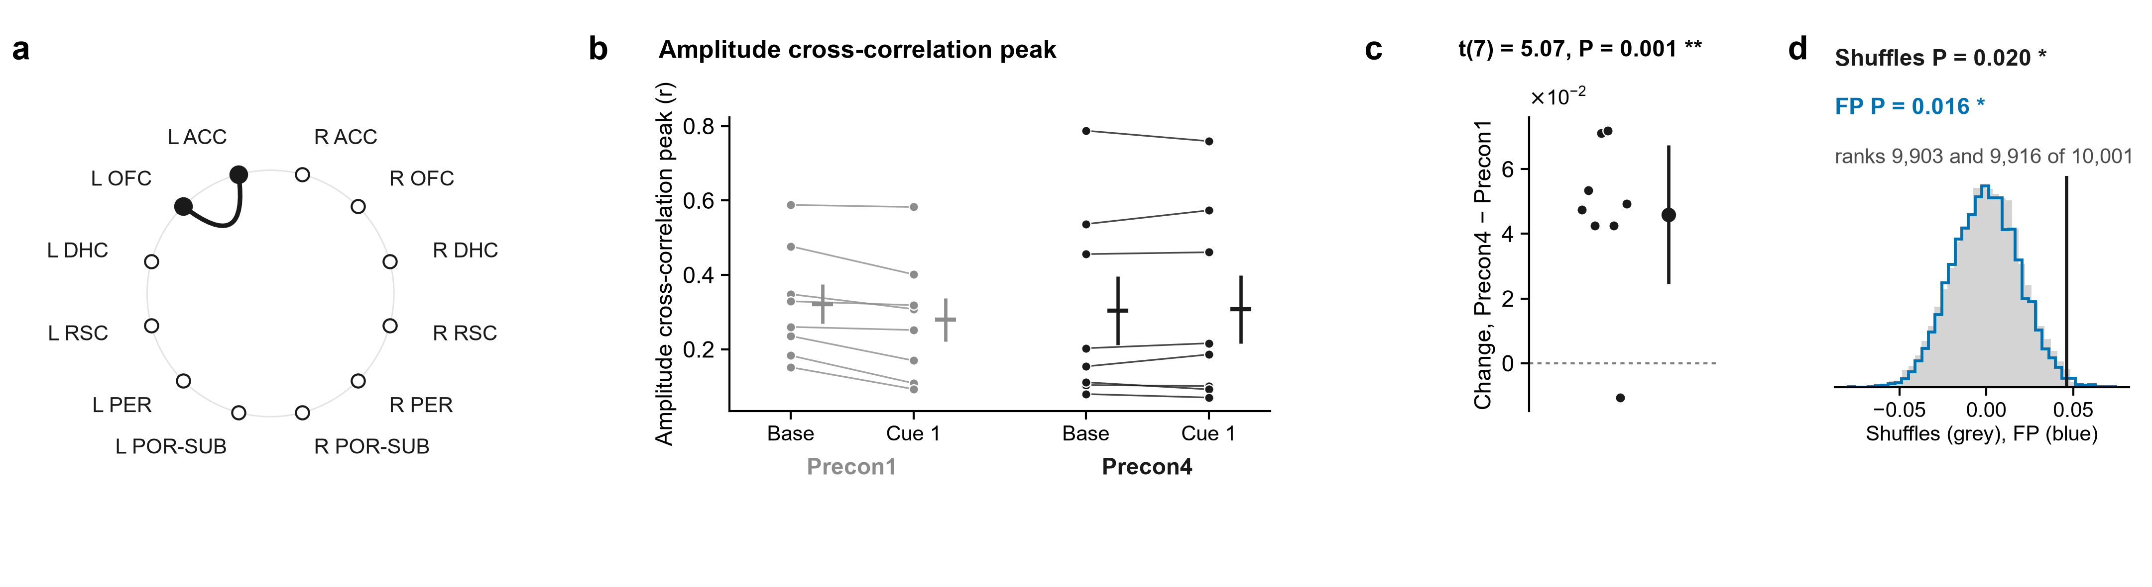
2.13 · L OFC – L ACC · Bursts rise together
L OFC and L ACC gamma bursts rising together (amplitude correlation): cue − baseline was higher on Precon4 than on Precon1.
L ACC predicting L RSC (Granger L ACC → L RSC): cue − baseline was higher on Precon4 than on Precon1.
t-test P = 0.030 (7 rats). Shuffles P = 0.008. FP P = 0.040. Both second opinions agree: a stronger lead.
t-test P = 0.001 (8 rats). Shuffles P = 0.020. FP P = 0.016. Both second opinions agree: a stronger lead.
Notes:
Baseline (10 s) → cue 1, gamma, L OFC – L ACC: amplitudes together. a, the pair on the ring of regions. Then, for each measure: its value for each rat at Baseline (10 s) and Cue 1 on Precon1 (grey) and Precon4 (black), each rat's two windows joined, the mean ± s.e.m. beside them; each rat's change between the days, (Precon4 Cue 1 − Baseline (10 s)) − (Precon1 Cue 1 − Baseline (10 s)), with the mean ± 95% confidence interval; and that mean against 10,000 shuffles in which each session's trials had their two windows swapped at random (grey) and against 10,000 sets of fake trials from the same rats' FP1 and FP2, where there were no cues, each session as many as it had real trials, in random order, losing the windows its real trials lost (blue). The pair was followed up because its own change in coherence had P < 0.05 (uncorrected; no pair survives correction on its own), and of the measures run on it these are the ones whose t-test had P < 0.05: they are leads, chosen by that test. Amplitude cross-correlation peak: t(7) = 5.07, P = 0.001 (one-sample t-test of each rat's change, uncorrected); within-session shuffles P = 0.020, rank 9,903 of 10,001; FP intervals P = 0.016, rank 9,916 of 10,001.

Slide 95
2.13 · L OFC – L ACC · Bursts rise together
L OFC and L ACC gamma bursts rising together (amplitude correlation): cue − baseline was higher on Precon4 than on Precon1.
From Precon1 to Precon4 the cues’ effect on gamma coherence swung across the network: on Precon1 they lowered it in 31 of 44 pairs; on Precon4, about even (23 up, 21 down).
t-test P = 0.001 (8 rats). Shuffles P = 0.020. FP P = 0.016. Both second opinions agree: a stronger lead.
Notes:
t(7) = 5.07, P = 0.001; mean change 0.04594. Shuffles: rank 9903 of 10001, P = 0.020. FP: rank 9916 of 10001, P = 0.016.

Slide 96
What it adds up to
From Precon1 to Precon4 the cues’ effect on gamma coherence swung across the network: on Precon1 they lowered it in 31 of 44 pairs; on Precon4, about even (23 up, 21 down).
L OFC and L ACC gamma bursts rising together (amplitude correlation): cue − baseline was higher on Precon4 than on Precon1.
t-test P = 0.001 (8 rats). Shuffles P = 0.020. FP P = 0.016. Both second opinions agree: a stronger lead.
The rats agreed on that swing: Figure 1, increases P = 0.012, ups and downs together P = 0.023. Neither the trial shuffle (P = 0.187) nor FP (P = 0.199) confirms Figure 1.

Slide 97
What it adds up to
From Precon1 to Precon4 the cues’ effect on gamma coherence swung across the network: on Precon1 they lowered it in 31 of 44 pairs; on Precon4, about even (23 up, 21 down).
The rats agreed on that swing: Figure 1, increases P = 0.012, ups and downs together P = 0.023. Neither the trial shuffle (P = 0.187) nor FP (P = 0.199) confirms Figure 1.
Figure 2 (cue 1): the increases pass every test (rats P = 0.027, trials P = 0.030, FP P = 0.037).

Slide 98
What it adds up to
From Precon1 to Precon4 the cues’ effect on gamma coherence swung across the network: on Precon1 they lowered it in 31 of 44 pairs; on Precon4, about even (23 up, 21 down).
Of the 20 follow-up figures, 9 pass both second opinions (1.2, 1.3, 1.4, 2.1, 2.3, 2.4, 2.9, 2.12, 2.13) and 5 pass one (1.5, 2.2, 2.7, 2.10, 2.11). They were picked from 190 t-tests, 21 of which passed where about 10 would by chance.
The rats agreed on that swing: Figure 1, increases P = 0.012, ups and downs together P = 0.023. Neither the trial shuffle (P = 0.187) nor FP (P = 0.199) confirms Figure 1.
Figure 2 (cue 1): the increases pass every test (rats P = 0.027, trials P = 0.030, FP P = 0.037).

Slide 99
What it adds up to
Of the 20 follow-up figures, 9 pass both second opinions (1.2, 1.3, 1.4, 2.1, 2.3, 2.4, 2.9, 2.12, 2.13) and 5 pass one (1.5, 2.2, 2.7, 2.10, 2.11). They were picked from 190 t-tests, 21 of which passed where about 10 would by chance.
From Precon1 to Precon4 the cues’ effect on gamma coherence swung across the network: on Precon1 they lowered it in 31 of 44 pairs; on Precon4, about even (23 up, 21 down).
The rats agreed on that swing: Figure 1, increases P = 0.012, ups and downs together P = 0.023. Neither the trial shuffle (P = 0.187) nor FP (P = 0.199) confirms Figure 1.
FP is the most physiological of the three yardsticks: it carries what these rats’ brains do with no cues, with every session’s own lost windows. A result it passes and the shuffle does not is still worth a second look.
Figure 2 (cue 1): the increases pass every test (rats P = 0.027, trials P = 0.030, FP P = 0.037).

Slide 100
What it adds up to
Of the 20 follow-up figures, 9 pass both second opinions (1.2, 1.3, 1.4, 2.1, 2.3, 2.4, 2.9, 2.12, 2.13) and 5 pass one (1.5, 2.2, 2.7, 2.10, 2.11). They were picked from 190 t-tests, 21 of which passed where about 10 would by chance.
FP is the most physiological of the three yardsticks: it carries what these rats’ brains do with no cues, with every session’s own lost windows. A result it passes and the shuffle does not is still worth a second look.
Nothing is corrected across tests, and the rings re-test the data that lit the light. All of this is leads to test again, not findings yet.

Slide 101
What it adds up to
Of the 20 follow-up figures, 9 pass both second opinions (1.2, 1.3, 1.4, 2.1, 2.3, 2.4, 2.9, 2.12, 2.13) and 5 pass one (1.5, 2.2, 2.7, 2.10, 2.11). They were picked from 190 t-tests, 21 of which passed where about 10 would by chance.
Everything is in Jarvis: tab 9 has each figure as PDF, SVG and PNG with its legend; tab 8 has the SPSS files to recreate the lights.
FP is the most physiological of the three yardsticks: it carries what these rats’ brains do with no cues, with every session’s own lost windows. A result it passes and the shuffle does not is still worth a second look.
Nothing is corrected across tests, and the rings re-test the data that lit the light. All of this is leads to test again, not findings yet.

Slide 102
What it adds up to
Everything is in Jarvis: tab 9 has each figure as PDF, SVG and PNG with its legend; tab 8 has the SPSS files to recreate the lights.
Of the 20 follow-up figures, 9 pass both second opinions (1.2, 1.3, 1.4, 2.1, 2.3, 2.4, 2.9, 2.12, 2.13) and 5 pass one (1.5, 2.2, 2.7, 2.10, 2.11). They were picked from 190 t-tests, 21 of which passed where about 10 would by chance.
FP is the most physiological of the three yardsticks: it carries what these rats’ brains do with no cues, with every session’s own lost windows. A result it passes and the shuffle does not is still worth a second look.
Nothing is corrected across tests, and the rings re-test the data that lit the light. All of this is leads to test again, not findings yet.
Notes:
Monolith page, tabs 8 (Joe's data) and 9 (Joe's figures). Questions to Shahriar.

